Slide 1
Bible Class October 2024

Slide 2
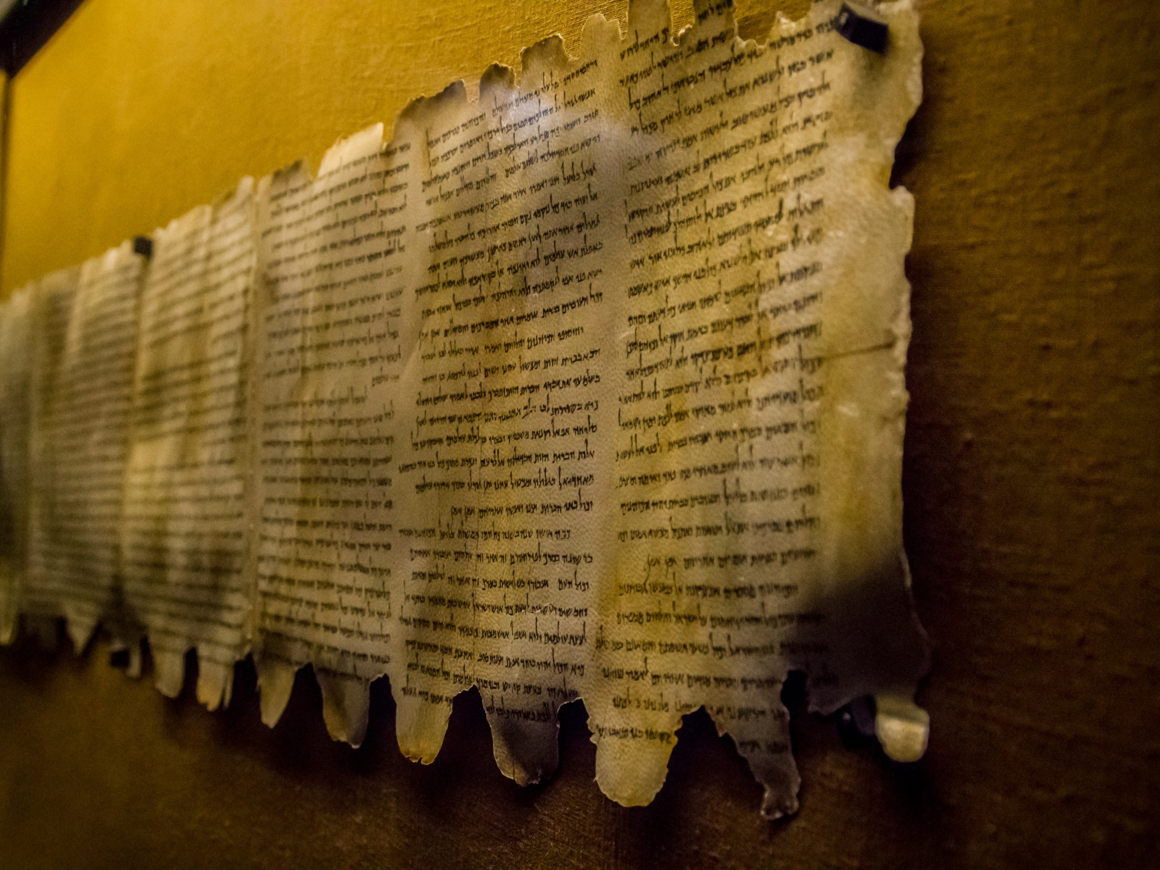
If the Bible has proved itself
to be reliable and true in the past,
it must also be reliable and true
in what it says about the future!

Slide 3
Things to come
2024
? | 4000BC | 2500BC | 2000BC | 1500BC | 0 | ?AD
Garden | The Fall |  |  |  | Christ
How is a time scale
like this possible?

Slide 4
Things to come
2024
? | 4000BC | 2500BC | 2000BC | 1500BC | 0 | ?AD
Garden | The Fall |  |  |  | Christ
Can we believe the dates and timescales used in the Bible?

Slide 5
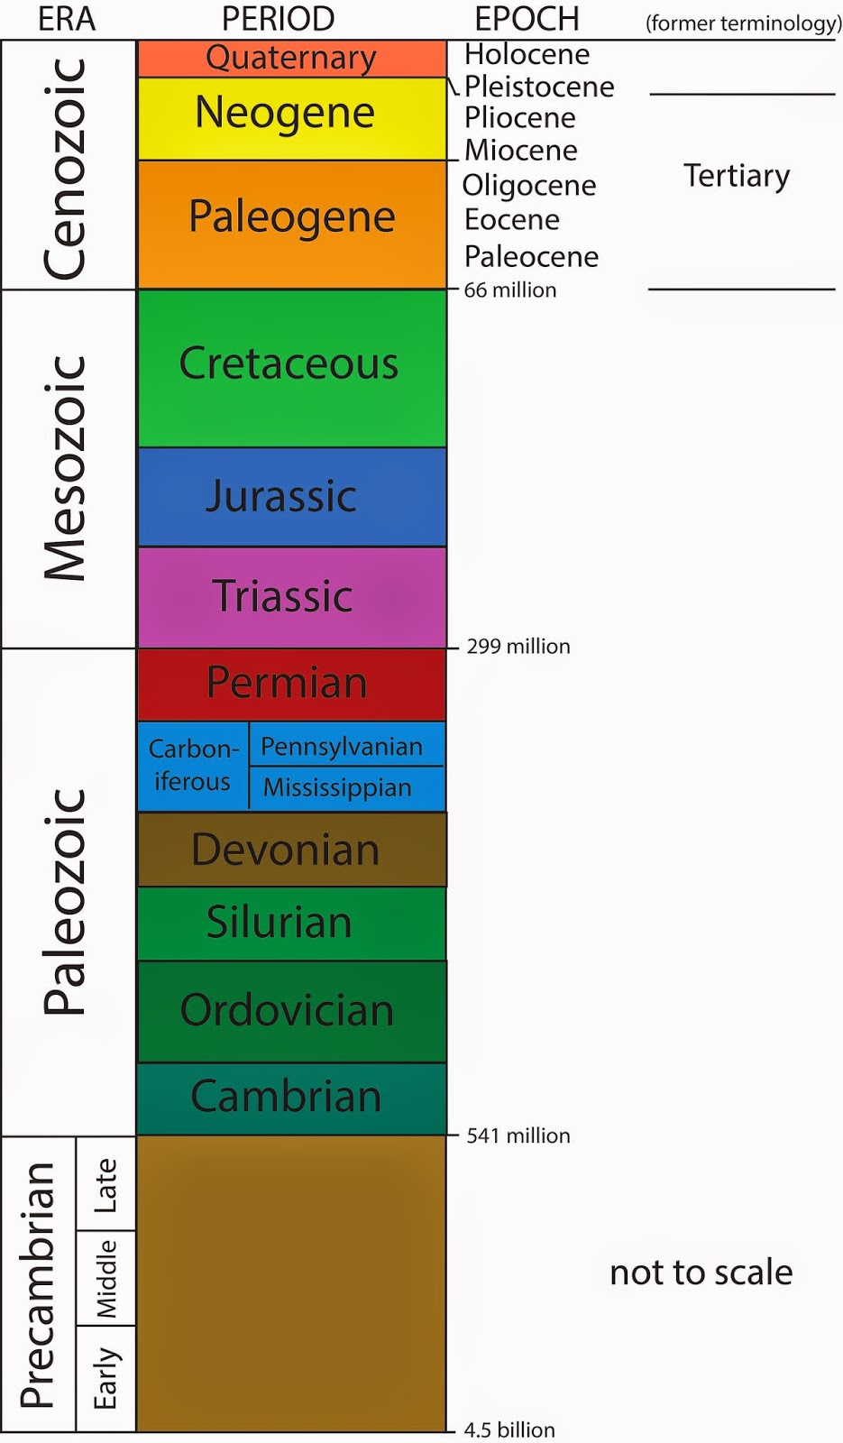
Things to come
2024
? | 4000BC | 2500BC | 2000BC | 1500BC | 0 | ?AD
Garden | The Fall |  |  |  | Christ
The Geological
Time Scale

Slide 6
Things to come
2024
? | 4000BC | 2500BC | 2000BC | 1500BC | 0 | ?AD
Garden | The Fall |  |  |  | Christ
How do we
reconcile this with 6000 years?

Slide 7
Things to come
2024
? | 4000BC | 2500BC | 2000BC | 1500BC | 0 | ?AD
Garden | The Fall |  |  |  | Christ
Geologists commonly use
radiometric dating methods
as reliable clocks to date ancient things.

Slide 8
Things to come
2024
? | 4000BC | 2500BC | 2000BC | 1500BC | 0 | ?AD
Garden | The Fall |  |  |  | Christ
Radioactive dating is a way to figure out how old something is:
It’s based on the fact that things on earth contain certain materials
that consistently change (decay) over time.
Since we know the exact rate of change (decay) in certain elements,
we can figure out exactly how old things are
based on the radioactive decay of the elements within them!

Slide 9
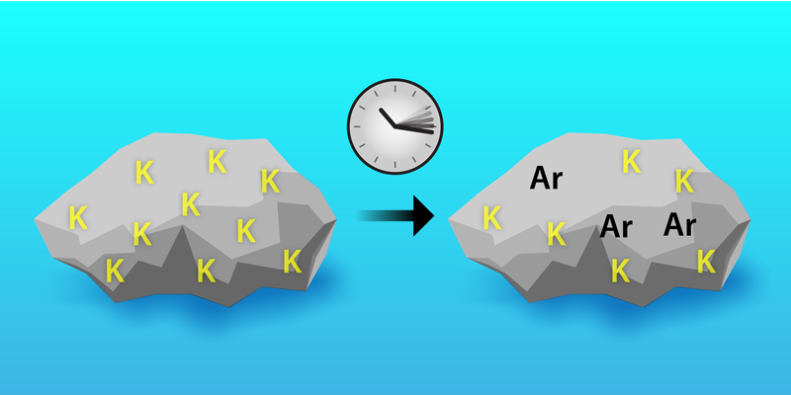
Things to come
2024
? | 4000BC | 2500BC | 2000BC | 1500BC | 0 | ?AD
Garden | The Fall |  |  |  | Christ
Radioactive dating is a way to figure out how old something is:
It’s based on the fact that things on earth contain certain materials
that consistently change (decay) over time.
Since we know the exact rate of change (decay) in certain elements,
we can figure out exactly how old things are
based on the radioactive decay of the elements within them!
Rocks can be dated by measuring their radioactive decay

Slide 10
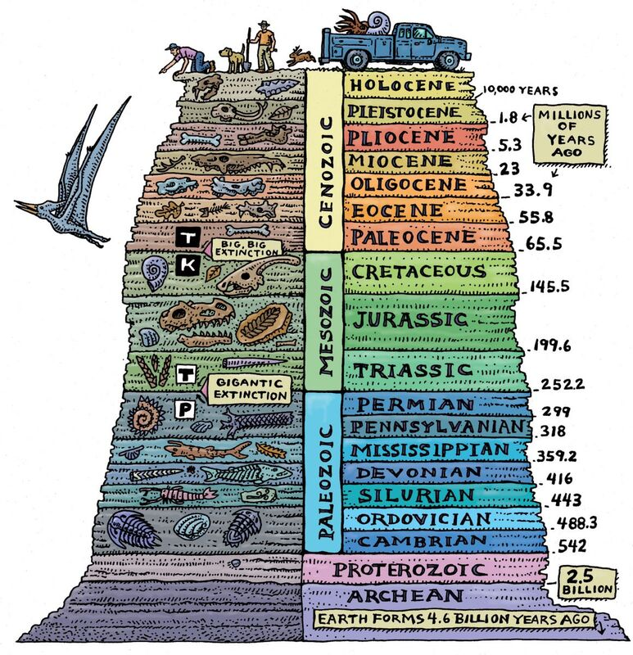
Things to come
2024
? | 4000BC | 2500BC | 2000BC | 1500BC | 0 | ?AD
Garden | The Fall |  |  |  | Christ
After dating the rocks
most other things are
dated by the rocks
they are found in

Slide 11
Things to come
2024
? | 4000BC | 2500BC | 2000BC | 1500BC | 0 | ?AD
Garden | The Fall |  |  |  | Christ
This is reasonably sound logic

Slide 12
Things to come
2024
? | 4000BC | 2500BC | 2000BC | 1500BC | 0 | ?AD
Garden | The Fall |  |  |  | Christ
These figures are
what we would expect to find
If everything followed
a consistent timeline.

Slide 13
Things to come
2024
? | 4000BC | 2500BC | 2000BC | 1500BC | 0 | ?AD
Garden | The Fall |  |  |  | Christ
But it completely ignores creation
at a point in time!

Slide 14
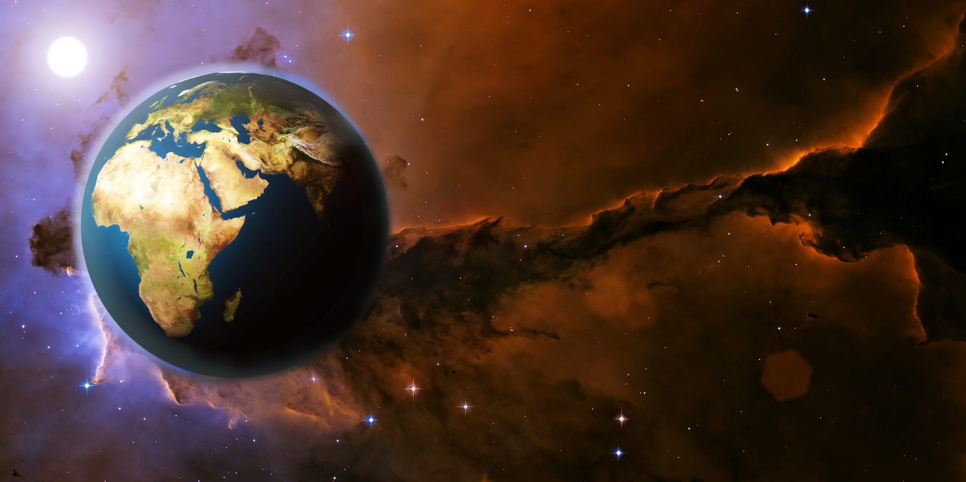
Things to come
2024
? | 4000BC | 2500BC | 2000BC | 1500BC | 0 | ?AD
Garden | The Fall |  |  |  | Christ
What role does creation play?

Slide 15
Things to come
2024
? | 4000BC | 2500BC | 2000BC | 1500BC | 0 | ?AD
Garden | The Fall |  |  |  | Christ
When something is created
age is automatically built in

Slide 16
Things to come
2024
? | 4000BC | 2500BC | 2000BC | 1500BC | 0 | ?AD
Garden | The Fall |  |  |  | Christ
When something is created
age is automatically built in
For example:
If a man is created:
He does not look like a baby
He is fully grown
You would naturally expect someone who looks like that to have lived at least into his late teens.
Every measurement taken
would indicate 15-20 years!

Slide 17
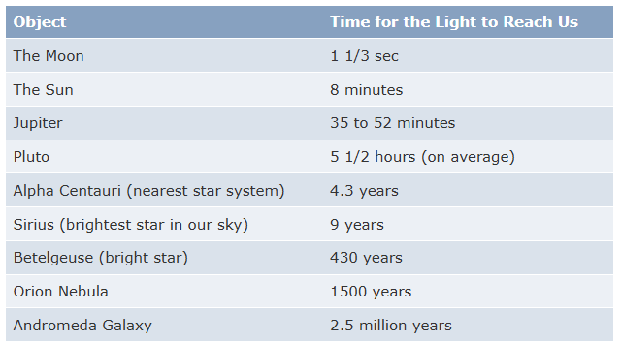
Things to come
2024
? | 4000BC | 2500BC | 2000BC | 1500BC | 0 | ?AD
Garden | The Fall |  |  |  | Christ

Slide 18
Things to come
2024
? | 4000BC | 2500BC | 2000BC | 1500BC | 0 | ?AD
Garden | The Fall |  |  |  | Christ
But when God created the stars,
the light from them appeared immediately in day 4 of creation week.

Slide 19
Things to come
2024
? | 4000BC | 2500BC | 2000BC | 1500BC | 0 | ?AD
Garden | The Fall |  |  |  | Christ
If we take a tree
that was created yesterday
It would just look like a normal tree
How would we date that tree?

Slide 20
Things to come
2024
? | 4000BC | 2500BC | 2000BC | 1500BC | 0 | ?AD
Garden | The Fall |  |  |  | Christ
If we take a tree
that was created yesterday
It would just look like a normal tree
How would we date that tree?

Slide 21
Things to come
2024
? | 4000BC | 2500BC | 2000BC | 1500BC | 0 | ?AD
Garden | The Fall |  |  |  | Christ
If we take a rock that was created yesterday, It would just look like a normal rock
How would we date that rock?

Slide 22
Things to come
2024
? | 4000BC | 2500BC | 2000BC | 1500BC | 0 | ?AD
Garden | The Fall |  |  |  | Christ
If we take a rock that was created yesterday, It would just look like a normal rock
How would we date that rock?
Rocks can be dated by measuring their radioactive decay
which would return a date in the order of billions of years

Slide 23
Things to come
2024
? | 4000BC | 2500BC | 2000BC | 1500BC | 0 | ?AD
Garden | The Fall |  |  |  | Christ
When you believe that
In the beginning
God created the heaven and the earth
The biblical timescale is completely understandable
and so are the dates that scientists come up with.

Slide 24
Things to come
2024
? | 4000BC | 2500BC | 2000BC | 1500BC | 0 | ?AD
Garden | The Fall |  |  |  | Christ
By faith we understand
that the universe was created
by the word of God.
Hebrews 11:3

Slide 25
Things to come
2024
Innocence
? | 4000BC | 2500BC | 2000BC | 1500BC | 0 | ?AD
Garden |  |  |  |  | Christ
When the world was first created, it was a perfect world,
Adam & Eve were not sinners, they were not holy, but were innocent.
God dealt with man in the dispensation of innocence

Slide 26
Things to come
2024
Innocence
? | 4000BC | 2500BC | 2000BC | 1500BC | 0 | ?AD
Garden | The Fall |  |  |  | Christ
When the world was first created, it was a perfect world,
Adam & Eve were not sinners, they were not holy, but were innocent.
God dealt with man in the dispensation of innocence

Slide 27
Things to come
2024
Innocence | Conscience | Human Government | Promise | Law | Grace | Kingdom
? | 4000BC | 2500BC | 2000BC | 1500BC | 0 | ?AD
Garden | The Fall | The Flood | Abraham | Moses | Christ | Kingdom
History
Future

Slide 28
Things to come
2024
Innocence | Conscience | Human Government | Promise | Law | Grace | Kingdom
? | 4000BC | 2500BC | 2000BC | 1500BC | 0 | ?AD
Garden | The Fall | The Flood | Abraham | Moses | Christ | Kingdom
The Bible is the only book
that accurately foretells the future
History
Future

Slide 29
Things to come
2024
Remember the former things of old: for I am God, and there is none else; I am God, and there is none like me, Declaring the end from the beginning, and from ancient times
the things that are not yet done, saying, My counsel shall stand, and I will do all my pleasure:
Isaiah 46:9-10
Innocence | Conscience | Human Government | Promise | Law | Grace | Kingdom
? | 4000BC | 2500BC | 2000BC | 1500BC | 0 | ?AD
Garden | The Fall | The Flood | Abraham | Moses | Christ | Kingdom
History
Future

Slide 30
Things to come
608 bc
Innocence | Conscience | Human Government | Promise | Law | Grace | Kingdom
? | 4000BC | 2500BC | 2000BC | 1500BC | 0 | ?AD
Garden | The Fall | The Flood | Abraham | Moses | Christ | Kingdom
History
Future
As an example of
God revealing the future,
we can go back
to the year 608 BC

Slide 31
Things to come
608 bc
Innocence | Conscience | Human Government | Promise | Law | Grace | Kingdom
? | 4000BC | 2500BC | 2000BC | 1500BC | 0 | ?AD
Garden | The Fall | The Flood | Abraham | Moses | Christ | Kingdom
God was ruling through the Jews
Times of the Gentiles
Luke 21:24
Nebuchadnezzar conquered Jerusalem (608 BC)
Nebuchadnezzar was the King of the first kingdom
that God permitted to rule

Slide 32
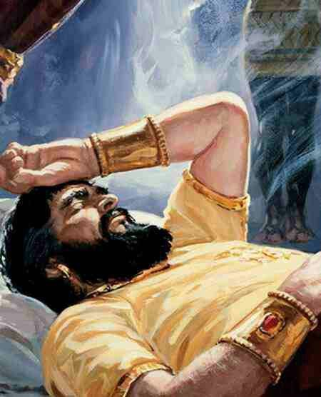
Read Daniel ch.2:
v1-2, 19, 24-25, 27-29

Slide 33
As for thee, O king,
thy thoughts came into thy mind upon thy bed, what should come to pass hereafter?
and he that revealeth secrets maketh known to thee
what shall come to pass.
Daniel 2v29

Slide 34
Thou, O king, sawest,
and behold a great image.
This great image, whose brightness was excellent, stood before thee;
and the form thereof was terrible.
This image's head was of fine gold,
his breast and his arms of silver,
his belly and his thighs of brass,
His legs of iron,
his feet part of iron and part of clay.
Thou sawest till that a stone was cut out without hands,
which smote the image upon his feet
that were of iron and clay, and brake them to pieces.
Then was the iron, the clay, the brass, the silver, and the gold,
broken to pieces together,
and became like the chaff of the summer threshing floors;
and the wind carried them away,
that no place was found for them:
and the stone that smote the image became a great mountain,
and filled the whole earth.
Daniel 2:31-35

Slide 35
Thou, O king, sawest,
and behold a great image.
This great image, whose brightness was excellent, stood before thee;
and the form thereof was terrible.
v32 This image's head was of fine gold,
his breast and his arms of silver,
his belly and his thighs of brass,
His legs of iron,
his feet part of iron and part of clay.
Thou sawest till that a stone was cut out without hands,
which smote the image upon his feet
that were of iron and clay, and brake them to pieces.
Then was the iron, the clay, the brass, the silver, and the gold,
broken to pieces together,
and became like the chaff of the summer threshing floors;
and the wind carried them away,
that no place was found for them:
and the stone that smote the image became a great mountain,
and filled the whole earth.
Daniel 2:31-35

Slide 36
Daniel 2:36-43
This is the dream; and we will tell the interpretation thereof before the king. Thou, O king, art a king of kings:
for the God of heaven hath given thee a kingdom, power, and strength, and glory.
³⁸ …Thou art this head of gold.

Slide 37
Babylonian
began 608 bc
Daniel 2:36-43
This is the dream; and we will tell the interpretation thereof before the king. Thou, O king, art a king of kings:
for the God of heaven hath given thee a kingdom, power, and strength, and glory.
³⁸ …Thou art this head of gold.

Slide 38
Babylonian
began 608 bc
Daniel 2:36-43
This is the dream; and we will tell the interpretation thereof before the king. Thou, O king, art a king of kings:
for the God of heaven hath given thee a kingdom, power, and strength, and glory.
³⁸ …Thou art this head of gold.
³⁹ And after thee shall arise another kingdom inferior to thee,

Slide 39
Babylonian
Medes
and Persians
began 608 bc
began 539 bc
Daniel 2:36-43
This is the dream; and we will tell the interpretation thereof before the king. Thou, O king, art a king of kings:
for the God of heaven hath given thee a kingdom, power, and strength, and glory.
³⁸ …Thou art this head of gold.
³⁹ And after thee shall arise another kingdom inferior to thee,

Slide 40
Babylonian
Medes
and Persians
began 608 bc
began 539 bc
Daniel 2:36-43
This is the dream; and we will tell the interpretation thereof before the king. Thou, O king, art a king of kings:
for the God of heaven hath given thee a kingdom, power, and strength, and glory.
³⁸ …Thou art this head of gold.
³⁹ And after thee shall arise another kingdom inferior to thee,
and another third kingdom of brass, which shall bear rule over all the earth.

Slide 41
Babylonian
Medes
and Persians
Greece
began 608 bc
began 539 bc
began 334 bc
Daniel 2:36-43
This is the dream; and we will tell the interpretation thereof before the king. Thou, O king, art a king of kings:
for the God of heaven hath given thee a kingdom, power, and strength, and glory.
³⁸ …Thou art this head of gold.
³⁹ And after thee shall arise another kingdom inferior to thee,
and another third kingdom of brass, which shall bear rule over all the earth.

Slide 42
Babylonian
Medes
and Persians
Greece
began 608 bc
began 539 bc
began 334 bc
Daniel 2:36-43
This is the dream; and we will tell the interpretation thereof before the king. Thou, O king, art a king of kings:
for the God of heaven hath given thee a kingdom, power, and strength, and glory.
³⁸ …Thou art this head of gold.
³⁹ And after thee shall arise another kingdom inferior to thee,
and another third kingdom of brass, which shall bear rule over all the earth.
⁴⁰ And the fourth kingdom shall be strong as iron:

Slide 43
Babylonian
Medes
and Persians
Greece
Roman
Empire
began 608 bc
began 539 bc
began 334 bc
began 27 bc
Daniel 2:36-43
This is the dream; and we will tell the interpretation thereof before the king. Thou, O king, art a king of kings:
for the God of heaven hath given thee a kingdom, power, and strength, and glory.
³⁸ …Thou art this head of gold.
³⁹ And after thee shall arise another kingdom inferior to thee,
and another third kingdom of brass, which shall bear rule over all the earth.
⁴⁰ And the fourth kingdom shall be strong as iron:

Slide 44
Babylonian
Medes
and Persians
Greece
Roman
Empire
began 608 bc
began 539 bc
began 334 bc
began 27 bc
Daniel 2:36-43
This is the dream; and we will tell the interpretation thereof before the king. Thou, O king, art a king of kings:
for the God of heaven hath given thee a kingdom, power, and strength, and glory.
³⁸ …Thou art this head of gold.
³⁹ And after thee shall arise another kingdom inferior to thee,
and another third kingdom of brass, which shall bear rule over all the earth.
⁴⁰ And the fourth kingdom shall be strong as iron:
⁴¹ And whereas thou sawest the feet and toes, part of potters' clay, and part of iron, the kingdom shall be divided;
⁴² And as the toes of the feet were part of iron, and part of clay, so the kingdom shall be partly strong, and partly broken.

Slide 45
Babylonian
Medes
and Persians
Greece
Roman
Empire
Final kingdom
of the Gentiles
began 608 bc
began 539 bc
began 334 bc
began 27 bc
?
Daniel 2:36-43
This is the dream; and we will tell the interpretation thereof before the king. Thou, O king, art a king of kings:
for the God of heaven hath given thee a kingdom, power, and strength, and glory.
³⁸ …Thou art this head of gold.
³⁹ And after thee shall arise another kingdom inferior to thee,
and another third kingdom of brass, which shall bear rule over all the earth.
⁴⁰ And the fourth kingdom shall be strong as iron:
⁴¹ And whereas thou sawest the feet and toes, part of potters' clay, and part of iron, the kingdom shall be divided;
⁴² And as the toes of the feet were part of iron, and part of clay, so the kingdom shall be partly strong, and partly broken.

Slide 46
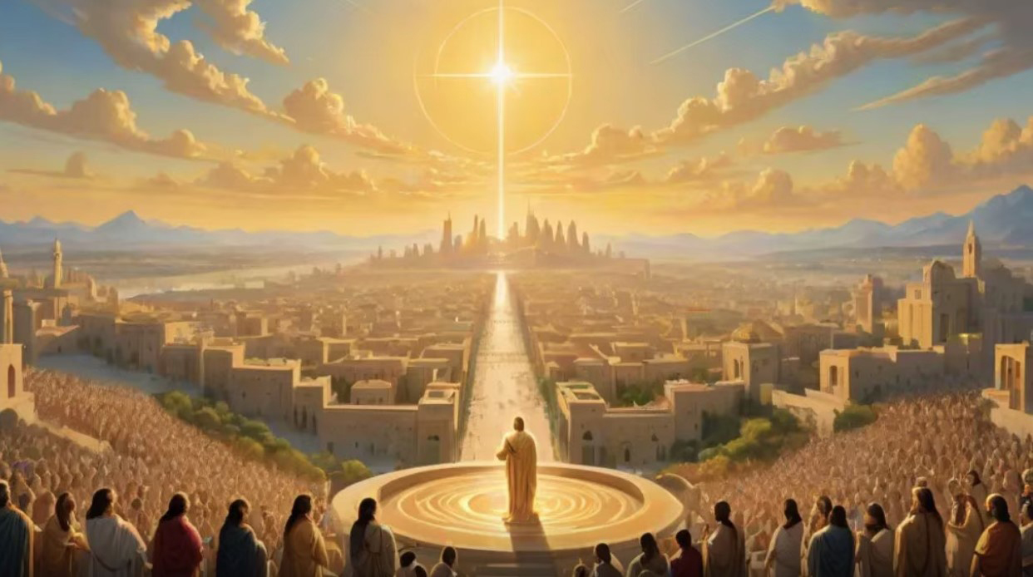
Babylonian
Medes
and Persians
Greece
Roman
Empire
Final kingdom
of the Gentiles
began 608 bc
began 539 bc
began 334 bc
began 27 bc
?
Daniel 2:44-45
And in the days of these kings shall the God of heaven set up a kingdom,
which shall never be destroyed: and the kingdom shall not be left to other people,
but it shall break in pieces and consume all these kingdoms, and it shall stand for ever.
Forasmuch as thou sawest that the stone was cut out of the mountain without hands,
and that it brake in pieces the iron, the brass, the clay, the silver, and the gold;
the great God hath made known to the king what shall come to pass hereafter:
and the dream is certain, and the interpretation thereof sure.

Slide 47
Things to come
608 bc
Innocence | Conscience | Human Government | Promise | Law | Grace | Kingdom
? | 4000BC | 2500BC | 2000BC | 1500BC | 0 | ?AD
Garden | The Fall | The Flood | Abraham | Moses | Christ | Kingdom
The image fits in here
God was ruling through the Jews
Times of the Gentiles
Nebuchadnezzar conquered Jerusalem (608 BC)
Nebuchadnezzar was the King of the first kingdom
that God permitted to rule

Slide 48
Things to come
Law | Grace | Kingdom
608 bc | 0 | ?AD
 | Christ | Kingdom

Slide 49
Things to come
Law |  |  |  | Grace | Kingdom
Babylonian | Medes & Persians | Greece | Rome |  | Last
608 bc |  |  |  | 0 | ?AD
 |  |  |  | Christ | Kingdom

Slide 50
Things to come
History verifies
what the Bible predicted!
Law |  |  |  | Grace | Kingdom
Babylonian | Medes & Persians | Greece | Rome |  | Last
608 bc |  |  |  | 0 | ?AD
 |  |  |  | Christ | Kingdom

Slide 51
Things to come
Law |  |  |  | Grace | Kingdom
Babylonian | Medes & Persians | Greece | Rome |  | Last
608 bc |  |  |  | 0 | ?AD
 |  |  |  | Christ | Kingdom

Slide 52
Things to come
Law |  |  |  | Grace | Kingdom
Babylonian | Medes & Persians | Greece | Rome |  | Last
608 bc |  |  |  | 0 | ?AD
 |  |  |  | Christ | Kingdom

Slide 53
Things to come
Law |  |  |  | Grace | Kingdom
Babylonian | Medes & Persians | Greece | Rome |  | Last
608 bc |  |  |  | 0 | ?AD
 |  |  |  | Christ | Kingdom

Slide 54
Things to come
Law |  |  |  | Grace | Kingdom
Babylonian | Medes & Persians | Greece | Rome |  | Last
608 bc |  |  |  | 0 | ?AD
 |  |  |  | Christ | Kingdom

Slide 55
Things to come
Yet - the Bible foretold
this series of world leadership
before history was written!
These nations are named in Scripture!
Law |  |  |  | Grace | Kingdom
Babylonian | Medes & Persians | Greece | Rome |  | Last
608 bc |  |  |  | 0 | ?AD
 |  |  |  | Christ | Kingdom

Slide 56
Things to come
Law |  |  |  | Grace | Kingdom
Babylonian | Medes & Persians | Greece | Rome |  | Last
608 bc |  |  |  | 0 | ?AD
 |  |  |  | Christ | Kingdom
Babylon
Thou art this
head of gold!
Daniel 2v38

Slide 57
Things to come
Law |  |  |  | Grace | Kingdom
Babylonian | Medes & Persians | Greece | Rome |  | Last
608 bc |  |  |  | 0 | ?AD
 |  |  |  | Christ | Kingdom
Babylon
Thou art this
head of gold!
Daniel 2v38
Medes & Persians
So this Daniel prospered in the reign of Darius, and in the reign of Cyrus the Persian.
Daniel 6v28

Slide 58
Things to come
Law |  |  |  | Grace | Kingdom
Babylonian | Medes & Persians | Greece | Rome |  | Last
608 bc |  |  |  | 0 | ?AD
 |  |  |  | Christ | Kingdom
Babylon
Thou art this
head of gold!
Daniel 2v38
Medes & Persians
So this Daniel prospered in the reign of Darius, and in the reign of Cyrus the Persian.
Daniel 6v28
Greece
…when I am gone forth, lo, the prince of Grecia shall come.
Daniel 10v20

Slide 59
Things to come
Law |  |  |  | Grace | Kingdom
Babylonian | Medes & Persians | Greece | Rome |  | Last
608 bc |  |  |  | 0 | ?AD
 |  |  |  | Christ | Kingdom
Babylon
Thou art this
head of gold!
Daniel 2v38
Medes & Persians
So this Daniel prospered in the reign of Darius, and in the reign of Cyrus the Persian.
Daniel 6v28
Greece
…when I am gone forth, lo, the prince of Grecia shall come.
Daniel 10v20
Rome
Now in the fifteenth year of the reign of Tiberius Caesar
Luke 3v1

Slide 60
Things to come
History verifies
what the Bible foretold!
Law |  |  |  | Grace | Kingdom
Babylonian | Medes & Persians | Greece | Rome |  | Last
608 bc |  |  |  | 0 | ?AD
 |  |  |  | Christ | Kingdom
Babylon
Thou art this
head of gold!
Daniel 2v38
Medes & Persians
So this Daniel prospered in the reign of Darius, and in the reign of Cyrus the Persian.
Daniel 6v28
Greece
…when I am gone forth, lo, the prince of Grecia shall come.
Daniel 10v20
Rome
Now in the fifteenth year of the reign of Tiberius Caesar
Luke 3v1

Slide 61
Things to come
The statue is how man viewed these kingdoms
But God viewed them differently!
Law |  |  |  | Grace | Kingdom
Babylonian | Medes & Persians | Greece | Rome |  | Last
608 bc |  |  |  | 0 | ?AD
 |  |  |  | Christ | Kingdom
Babylon
Thou art this
head of gold!
Daniel 2v38
Medes & Persians
So this Daniel prospered in the reign of Darius, and in the reign of Cyrus the Persian.
Daniel 6v28
Greece
…when I am gone forth, lo, the prince of Grecia shall come.
Daniel 10v20
Rome
Now in the fifteenth year of the reign of Tiberius Caesar
Luke 3v1
Last Kingdom of men
the kingdom shall be divided;
Daniel 2v41

Slide 62
Things to come
God revealed how he viewed these kingdoms
in Daniel chapter 7
Law |  |  |  | Grace | Kingdom
Babylonian | Medes & Persians | Greece | Rome |  | Last
608 bc |  |  |  | 0 | ?AD
 |  |  |  | Christ | Kingdom
Babylon
Thou art this
head of gold!
Daniel 2v38
Medes & Persians
So this Daniel prospered in the reign of Darius, and in the reign of Cyrus the Persian.
Daniel 6v28
Greece
…when I am gone forth, lo, the prince of Grecia shall come.
Daniel 10v20
Rome
Now in the fifteenth year of the reign of Tiberius Caesar
Luke 3v1
Last Kingdom of men
the kingdom shall be divided;
Daniel 2v41

Slide 63
Things to come
Daniel 7:1-3
In the first year of Belshazzar king of Babylon
Daniel had a dream and visions of his head upon his bed:
then he wrote the dream, and told the sum of the matters.
Daniel spake and said, I saw in my vision by night, and, behold,
the four winds of the heaven strove upon the great sea.
and four great beasts came up from the sea,
diverse one from another.
The beasts represent the same 4 world empires that were expressed by the image in chapter 2:
Except now they are seen as God viewed them,
Cruel, exhibiting the savagery of ferocious animals.
Law |  |  |  | Grace | Kingdom
Babylonian | Medes & Persians | Greece | Rome |  | Last
608 bc |  |  |  | 0 | ?AD
 |  |  |  | Christ | Kingdom
Babylon
Thou art this
head of gold!
Daniel 2v38
Medes & Persians
So this Daniel prospered in the reign of Darius, and in the reign of Cyrus the Persian.
Daniel 6v28
Greece
…when I am gone forth, lo, the prince of Grecia shall come.
Daniel 10v20
Rome
Now in the fifteenth year of the reign of Tiberius Caesar
Luke 3v1
Last Kingdom of men
the kingdom shall be divided;
Daniel 2v41

Slide 64
Things to come
Law |  |  |  | Grace | Kingdom
Babylonian | Medes & Persians | Greece | Rome |  | Last
608 bc |  |  |  | 0 | ?AD
 |  |  |  | Christ | Kingdom
And four great beasts came up from the sea, diverse one from another.
The first was like a lion, and had eagle's wings
Daniel 7:3-4
Babylon
Thou art this
head of gold!
Daniel 2v38
Medes & Persians
So this Daniel prospered in the reign of Darius, and in the reign of Cyrus the Persian.
Daniel 6v28
Greece
…when I am gone forth, lo, the prince of Grecia shall come.
Daniel 10v20
Rome
Now in the fifteenth year of the reign of Tiberius Caesar
Luke 3v1
Last Kingdom
of men
the kingdom shall be divided;
Daniel 2v41

Slide 65
Things to come
Law |  |  |  | Grace | Kingdom
Babylonian | Medes & Persians | Greece | Rome |  | Last
608 bc |  |  |  | 0 | ?AD
 |  |  |  | Christ | Kingdom
The first beast represented Babylon; the lion
and the lion had eagle’s wings.
The lion was the national symbol of the Babylonians.
The lion is the king of the animal kingdom
The eagle is the head of the bird kingdom
Representing Babylon which was truly the head of all empires at the time.
It was represented by Gold in the image!
Babylon
Thou art this
head of gold!
Daniel 2v38
Medes & Persians
So this Daniel prospered in the reign of Darius, and in the reign of Cyrus the Persian.
Daniel 6v28
Greece
…when I am gone forth, lo, the prince of Grecia shall come.
Daniel 10v20
Rome
Now in the fifteenth year of the reign of Tiberius Caesar
Luke 3v1
Last Kingdom
of men
the kingdom shall be divided;
Daniel 2v41

Slide 66
Things to come
Law |  |  |  | Grace | Kingdom
Babylonian | Medes & Persians | Greece | Rome |  | Last
608 bc |  |  |  | 0 | ?AD
 |  |  |  | Christ | Kingdom
And behold another beast, a second, like to a bear, and it raised up itself on one side, and it had three ribs in the mouth of it between the teeth of it.
Daniel 7:3-5
Babylon
Thou art this
head of gold!
Daniel 2v38
Medes & Persians
So this Daniel prospered in the reign of Darius, and in the reign of Cyrus the Persian.
Daniel 6v28
Greece
…when I am gone forth, lo, the prince of Grecia shall come.
Daniel 10v20
Rome
Now in the fifteenth year of the reign of Tiberius Caesar
Luke 3v1
Last Kingdom
of men
the kingdom shall be divided;
Daniel 2v41

Slide 67
Things to come
Law |  |  |  | Grace | Kingdom
Babylonian | Medes & Persians | Greece | Rome |  | Last
608 bc |  |  |  | 0 | ?AD
 |  |  |  | Christ | Kingdom
The second beast which is the bear represented the Medo-Persian Empire which conquered Babylon.
A bear is powerful but not as regal as a lion.
Being ‘raised up on one side,’ likely refers to the uneven partnership of the Medes and Persians because the Persians eventually gained supremacy over the Medes
It was represented by Silver in the image!
Babylon
Thou art this
head of gold!
Daniel 2v38
Medes & Persians
So this Daniel prospered in the reign of Darius, and in the reign of Cyrus the Persian.
Daniel 6v28
Greece
…when I am gone forth, lo, the prince of Grecia shall come.
Daniel 10v20
Rome
Now in the fifteenth year of the reign of Tiberius Caesar
Luke 3v1
Last Kingdom
of men
the kingdom shall be divided;
Daniel 2v41

Slide 68
Things to come
After this I beheld, and lo another,
like a leopard, which had upon the back of it four wings of a fowl; the beast had also four heads; and dominion was given to it.
Daniel 7:3-6
Law |  |  |  | Grace | Kingdom
Babylonian | Medes & Persians | Greece | Rome |  | Last
608 bc |  |  |  | 0 | ?AD
 |  |  |  | Christ | Kingdom
Babylon
Thou art this
head of gold!
Daniel 2v38
Medes & Persians
So this Daniel prospered in the reign of Darius, and in the reign of Cyrus the Persian.
Daniel 6v28
Greece
…when I am gone forth, lo, the prince of Grecia shall come.
Daniel 10v20
Rome
Now in the fifteenth year of the reign of Tiberius Caesar
Luke 3v1
Last Kingdom
of men
the kingdom shall be divided;
Daniel 2v41

Slide 69
Things to come
A leopard is the fastest animal on earth. God chose this swift animal to represent the Grecian Empire, spearheaded by Alexander the Great the Macedonian, because of the rapid rise of its empire and ability to conquer other nations almost overnight, it had four wings.
Now when Alexander died in 323 BC, at 33 years old, his vast empire split among his four generals, represented by the four heads of this third beast.
It was represented by Brass in the image!
Law |  |  |  | Grace | Kingdom
Babylonian | Medes & Persians | Greece | Rome |  | Last
608 bc |  |  |  | 0 | ?AD
 |  |  |  | Christ | Kingdom
Babylon
Thou art this
head of gold!
Daniel 2v38
Medes & Persians
So this Daniel prospered in the reign of Darius, and in the reign of Cyrus the Persian.
Daniel 6v28
Greece
…when I am gone forth, lo, the prince of Grecia shall come.
Daniel 10v20
Rome
Now in the fifteenth year of the reign of Tiberius Caesar
Luke 3v1
Last Kingdom
of men
the kingdom shall be divided;
Daniel 2v41

Slide 70
Things to come
After this I saw in the night visions, and behold a fourth beast, dreadful and terrible, and strong exceedingly; and it had great iron teeth: it devoured and brake in pieces, and stamped the residue with the feet of it: and it was diverse from all the beasts that were before it; and it had ten horns.
Daniel 7:3-8
Law |  |  |  | Grace | Kingdom
Babylonian | Medes & Persians | Greece | Rome |  | Last
608 bc |  |  |  | 0 | ?AD
 |  |  |  | Christ | Kingdom
Babylon
Thou art this
head of gold!
Daniel 2v38
Medes & Persians
So this Daniel prospered in the reign of Darius, and in the reign of Cyrus the Persian.
Daniel 6v28
Greece
…when I am gone forth, lo, the prince of Grecia shall come.
Daniel 10v20
Rome
Now in the fifteenth year of the reign of Tiberius Caesar
Luke 3v1
Last Kingdom
of men
the kingdom shall be divided;
Daniel 2v41

Slide 71
Things to come
Law |  |  |  | Grace | Kingdom
Babylonian | Medes & Persians | Greece | Rome |  | Last
608 bc |  |  |  | 0 | ?AD
 |  |  |  | Christ | Kingdom
The fourth beast is no doubt the Roman Empire which appeared on the scene more ferocious than the previous empires.
Its great iron teeth spoke of its unequalled military strength and in its persecution of God’s people Rome is unrivalled.
Remember in the sacking of the Temple in Jerusalem, in 70 AD,
Titus slaughtered 1.1 million people.
It was represented by Iron in the image!
Babylon
Thou art this
head of gold!
Daniel 2v38
Medes & Persians
So this Daniel prospered in the reign of Darius, and in the reign of Cyrus the Persian.
Daniel 6v28
Greece
…when I am gone forth, lo, the prince of Grecia shall come.
Daniel 10v20
Rome
Now in the fifteenth year of the reign of Tiberius Caesar
Luke 3v1
Last Kingdom
of men
the kingdom shall be divided;
Daniel 2v41

Slide 72
Things to come
The statue is how man viewed these kingdoms
Law |  |  |  | Grace | Kingdom
Babylonian | Medes & Persians | Greece | Rome |  | Last
608 bc |  |  |  | 0 | ?AD
 |  |  |  | Christ | Kingdom
The beasts are how God viewed these kingdoms
Babylon
Thou art this
head of gold!
Daniel 2v38
Medes & Persians
So this Daniel prospered in the reign of Darius, and in the reign of Cyrus the Persian.
Daniel 6v28
Greece
…when I am gone forth, lo, the prince of Grecia shall come.
Daniel 10v20
Rome
Now in the fifteenth year of the reign of Tiberius Caesar
Luke 3v1
Last Kingdom
of men
the kingdom shall be divided;
Daniel 2v41

Slide 73
Things to come
All of this was in the future when Daniel wrote it.
History verifies that this was what happened
therefore…
We can rely on what the Bible says about the future.
Law |  |  |  | Grace | Kingdom
Babylonian | Medes & Persians | Greece | Rome |  | Last
608 bc |  |  |  | 0 | ?AD
 |  |  |  | Christ | Kingdom
Babylon
Thou art this
head of gold!
Daniel 2v38
Medes & Persians
So this Daniel prospered in the reign of Darius, and in the reign of Cyrus the Persian.
Daniel 6v28
Greece
…when I am gone forth, lo, the prince of Grecia shall come.
Daniel 10v20
Rome
Now in the fifteenth year of the reign of Tiberius Caesar
Luke 3v1
Last Kingdom
of men
the kingdom shall be divided;
Daniel 2v41

Slide 74
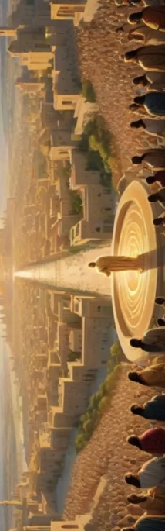
Babylonian
Medes
and Persians
Greece
Roman
Empire
Final kingdom
of the Gentiles
began 608 bc
began 539 bc
began 334 bc
began 27 bc
?
Daniel was born
about 625 BC
Daniel died
about 530 BC

Slide 75
Babylonian
Medes
and Persians
Greece
Roman
Empire
Final kingdom
of the Gentiles
began 608 bc
began 539 bc
began 334 bc
began 27 bc
?
Daniel was born
about 625 BC
Daniel died
about 530 BC
Daniel prophesied
from 606-535 BC

Slide 76
Babylonian
Medes
and Persians
Greece
Roman
Empire
Final kingdom
of the Gentiles
God told Daniel
in 606 BC
what was to come after Nebuchadnezzar
began 608 bc
began 539 bc
began 334 bc
began 27 bc
?
Daniel died about 530 BC
The book of Daniel
was finished sometime
before 530 BC
Daniel prophesied
from 606-535 BC

Slide 77
Babylonian
Medes
and Persians
Greece
Roman
Empire
Final kingdom
of the Gentiles
God told Daniel
in 606 BC
what was to come after Nebuchadnezzar
began 608 bc
began 539 bc
began 334 bc
began 27 bc
?
The Medes, Persians, Greeks and Romans were all in the future
Daniel died about 530 BC
The book of Daniel
was finished sometime
before 530 BC
Daniel prophesied
from 606-535 BC

Slide 78
The detail and accuracy
of Daniel’s prophecies
have drawn the attention
of many skeptics.
Babylonian
Medes
and Persians
Greece
Roman
Empire
Final kingdom
of the Gentiles
God told Daniel
in 606 BC
what was to come after Nebuchadnezzar
began 608 bc
began 539 bc
began 334 bc
began 27 bc
?
The Medes, Persians, Greeks and Romans were all in the future
Daniel died about 530 BC
The book of Daniel
was finished sometime
before 530 BC
Daniel prophesied
from 606-535 BC

Slide 79
Today, where do most people
go to find information?

Slide 80
Today, where do most people
go to find information?
Google search
or
Wikipedia

Slide 81
Wikipedia - Daniel
Daniel (lit. 'God is my Judge') is the main character of the Book of Daniel.
According to the Hebrew Bible, Daniel was a noble Jewish youth of Jerusalem taken into captivity
by Nebuchadnezzar II of Babylon.
He served the king and his successors with loyalty and ability until the time of the Persian conqueror Cyrus,
all the while remaining true to the God of Israel.
While some conservative scholars hold that Daniel existed and his book was written in the 6th century,
most scholars agree that Daniel is not a historical figure and that much of the book
is a cryptic allusion to the reign of the 2nd century Hellenistic king Antiochus IV Epiphanes.

Slide 82
Looking up Wikipedia…
doubt is immediately cast
on the authenticity of Daniel
Wikipedia - Daniel
Daniel (lit. 'God is my Judge') is the main character of the Book of Daniel.
According to the Hebrew Bible, Daniel was a noble Jewish youth of Jerusalem taken into captivity
by Nebuchadnezzar II of Babylon.
He served the king and his successors with loyalty and ability until the time of the Persian conqueror Cyrus,
all the while remaining true to the God of Israel.
While some conservative scholars hold that Daniel existed and his book was written in the 6th century,
most scholars agree that Daniel is not a historical figure and that much of the book
is a cryptic allusion to the reign of the 2nd century Hellenistic king Antiochus IV Epiphanes.

Slide 83
Wikipedia - Daniel
Daniel (lit. 'God is my Judge') is the main character of the Book of Daniel.
According to the Hebrew Bible, Daniel was a noble Jewish youth of Jerusalem taken into captivity
by Nebuchadnezzar II of Babylon.
He served the king and his successors with loyalty and ability until the time of the Persian conqueror Cyrus,
all the while remaining true to the God of Israel.
While some conservative scholars hold that Daniel existed and his book was written in the 6th century,
most scholars agree that Daniel is not a historical figure and that much of the book
is a cryptic allusion to the reign of the 2nd century Hellenistic king Antiochus IV Epiphanes.
In Summary, it is claimed:
Daniel is a forgery
It was written in 2nd Century BC (165BC) – not the 6th Century BC
It was not written by Daniel
It is not prophecy – but it is history, and badly researched history at that!

Slide 84
What do we understand
from the Biblical record?

Slide 85
What do we understand
from the Biblical record?
Matthew 24:15 – Jesus believed Daniel was real and called him a prophet
When ye therefore shall see the abomination of desolation,
spoken of by Daniel the prophet…
Mark 13:14 – Jesus said what Daniel spoke of was still in the future
But when ye shall see the abomination of desolation,
spoken of by Daniel the prophet, standing where it ought not…
Daniel 7:1 - Daniel wrote as he received the visions from God in the 6th Century BC
In the first year of Belshazzar king of Babylon Daniel had a dream and visions of his head upon his bed:
then he wrote the dream, and told the sum of the matters.
Daniel 10:1 – He continued to receive visions (and therefore write) throughout his life
In the third year of Cyrus king of Persia a thing was revealed unto Daniel, whose name was called Belteshazzar;
and the thing was true, but the time appointed was long: and he understood the thing,
and had understanding of the vision.
Daniel 12:4 – He was told (in the 3rd year of Cyrus) to finish the book.
But thou, O Daniel, shut up the words, and seal the book, even to the time of the end:

Slide 86
What do we understand
from the Biblical record?
According to the Scriptures:
Daniel was a real person who existed
Daniel was a prophet
Daniel wrote the book of Daniel
Daniel wrote the book of Daniel in the 6th Century
Daniel wrote of things that had not yet happened more than 600 years later in the 1st Century AD
Matthew 24:15 – Jesus believed Daniel was real and called him a prophet
When ye therefore shall see the abomination of desolation,
spoken of by Daniel the prophet…
Mark 13:14 – Jesus said what Daniel spoke of was still in the future
But when ye shall see the abomination of desolation,
spoken of by Daniel the prophet, standing where it ought not…
Daniel 7:1 - Daniel wrote as he received the visions from God in the 6th Century BC
In the first year of Belshazzar king of Babylon Daniel had a dream and visions of his head upon his bed:
then he wrote the dream, and told the sum of the matters.
Daniel 10:1 – He continued to receive visions (and therefore write) throughout his life
In the third year of Cyrus king of Persia a thing was revealed unto Daniel, whose name was called Belteshazzar;
and the thing was true, but the time appointed was long: and he understood the thing,
and had understanding of the vision.
Daniel 12:4 – He was told (in the 3rd year of Cyrus) to finish the book.
But thou, O Daniel, shut up the words, and seal the book, even to the time of the end:

Slide 87
What are some arguments put forward
by skeptics of the Book of Daniel?

Slide 88
What are some arguments put forward
by skeptics of the Book of Daniel?
Historical Accuracy:
The historical accuracy of things recorded in Daniel was and still is by some believed to be wrong:
This includes the writer’s knowledge of places, people and language.
For example, Daniel says that Belshazzar was the last king of Babylon while all other ancient historians
said it was Nadonidus. So secular historians simply disregarded Daniel,
believing that someone in the 2nd Century just made up Belshazzar out of thin air.
In the lists of Babylonian kings Belshazzar’s name is not listed, Nabonidus was the last king of Babylon

Slide 89
Is there
an answer for this?
What are some arguments put forward
by skeptics of the Book of Daniel?
Historical Accuracy:
The historical accuracy of things recorded in Daniel was and still is by some believed to be wrong:
This includes the writer’s knowledge of places, people and language.
For example, Daniel says that Belshazzar was the last king of Babylon while all other ancient historians
said it was Nadonidus. So secular historians simply disregarded Daniel,
believing that someone in the 2nd Century just made up Belshazzar out of thin air.
In the lists of Babylonian kings Belshazzar’s name is not listed, Nabonidus was the last king of Babylon

Slide 90
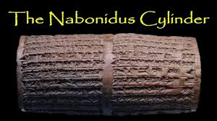
What are some arguments put forward
by skeptics of the Book of Daniel?
Historical Accuracy:
The historical accuracy of things recorded in Daniel was believed to be wrong:
For example, Daniel says that Belshazzar was the last king of Babylon while all other ancient historians
said it was Nadonidus. So secular historians simply disregarded Daniel,
believing that someone in the 2nd Century just made up Belshazzar out of thin air.
In the lists of Babylonian kings Belshazzar’s name is not listed, Nabonidus was the last king of Babylon
However:
In 1854, J.G. Taylor found four cuneiform cylinders in the foundation of a ziggurat at Ur.
These were deposited by the last King of Babylon, Nabonidus;
The Cylinders of Nabonidus refers to cuneiform inscriptions of king Nabonidus of Babylonia (556-539 BC).
These inscriptions were made on clay cylinders.

Slide 91
What are some arguments put forward
by skeptics of the Book of Daniel?
Historical Accuracy:
The historical accuracy of things recorded in Daniel was believed to be wrong:
For example, Daniel says that Belshazzar was the last king of Babylon while all other ancient historians
said it was Nadonidus. So secular historians simply disregarded Daniel,
believing that someone in the 2nd Century just made up Belshazzar out of thin air.
In the lists of Babylonian kings Belshazzar’s name is not listed, Nabonidus was the last king of Babylon
However:
In 1854, J.G. Taylor found four cuneiform cylinders in the foundation of a ziggurat at Ur.
These were deposited by the last King of Babylon, Nabonidus;
The Cylinders of Nabonidus refers to cuneiform inscriptions of king Nabonidus of Babylonia (556-539 BC).
These inscriptions were made on clay cylinders.
Extract: Cylinder iii.3-31
May it be that I, Nabonidus, king of Babylon, never fail you and may my firstborn,
Belshazzar, worship you with all his heart.
Extract Cylinder ii.18-29:
Nabonidus entrusted the army to his first born, the troops in the country he ordered under his command
He let everything go, entrusted the kingship to him, and himself, he started out for a long journey.

Slide 92
What are some arguments put forward
by skeptics of the Book of Daniel?
Historical Accuracy:
The historical accuracy of things recorded in Daniel was believed to be wrong:
For example, Daniel says that Belshazzar was the last king of Babylon while all other ancient historians
said it was Nadonidus. So secular historians simply disregarded Daniel,
believing that someone in the 2nd Century just made up Belshazzar out of thin air.
In the lists of Babylonian kings Belshazzar’s name is not listed, Nabonidus was the last king of Babylon
However:
In 1854, J.G. Taylor found four cuneiform cylinders in the foundation of a ziggurat at Ur.
These were deposited by the last King of Babylon, Nabonidus;
The Cylinders of Nabonidus refers to cuneiform inscriptions of king Nabonidus of Babylonia (556-539 BC).
These inscriptions were made on clay cylinders.
Extract: Cylinder iii.3-31
May it be that I, Nabonidus, king of Babylon, never fail you and may my firstborn,
Belshazzar, worship you with all his heart.
Extract Cylinder ii.18-29:
Nabonidus entrusted the army to his first born, the troops in the country he ordered under his command
He let everything go, entrusted the kingship to him, and himself, he started out for a long journey.
Daniel was proved to be correct, Belshazzar was left in charge
as king of Babylon, reigning as co-regent while Nadonidus was away:
Remember after the writing on the wall Belshazzar made Daniel the 3rd ruler!

Slide 93
What are some arguments put forward
by skeptics of the Book of Daniel?
Daniel’s Theology:
It is claimed that four elements in Daniel’s theology (angelology, resurrection, last judgment, and Messiah)
betray the second-century origin of Daniel because these particular truths are asserted to be so characteristic
of this second-century period.

Slide 94
What are some arguments put forward
by skeptics of the Book of Daniel?
Is there
an answer for this?
Daniel’s Theology:
It is claimed that four elements in Daniel’s theology (angelology, resurrection, last judgment, and Messiah)
betray the second-century origin of Daniel because these particular truths are asserted to be so characteristic
of this second-century period.

Slide 95
What are some arguments put forward
by skeptics of the Book of Daniel?
Daniel’s Theology:
It is claimed that four elements in Daniel’s theology (angelology, resurrection, last judgment, and Messiah)
betray the second-century origin of Daniel because these particular truths are asserted to be so characteristic
of this second-century period.
Consistent Bible Themes:
Zechariah’s prophecies date from approximately 519 to 470 B.C., and yet contain clearly Messianic themes
and references to angels (Zech 2:3; 3:1; 6:12; 9:9; 13:1; 14:5).
Furthermore, the role of angels in Zechariah, as in Daniel, is to interpret the meaning of the prophet’s visions.
The book of Malachi also contains two important references to the Messiah (Mal 3:1; 4:2)
and to the final judgment (Mal 3).
Other books which are admittedly of the second century B.C., such as 1 Maccabees
and the Greek additions to Daniel, to Baruch, and Judith, show none of these four elements.
There is no convincing reason to believe that Daniel’s theology was different to that shown consistently throughout
the Bible from Genesis, through the Law and the Kingdom that Messiah was coming and would set up an everlasting
Kingdom of righteousness for saints to enjoy.
Even Job (the first book to be written) states this in Job 19:26-27:
And though after my skin worms destroy this body, yet in my flesh shall I see God:
Whom I shall see for myself, and mine eyes shall behold.

Slide 96
What are some arguments put forward
by skeptics of the Book of Daniel?
Linguistic Data:
Daniel is written in several languages:
ch.1 - ch.2v4 is written in Hebrew
ch.2v5 - ch.7 is written in Aramaic
ch.8 - ch.12 is written in Hebrew
It also contains Greek words.
Greek Words:
It is argued that the book must be written after Alexander the great conquered the world
and introduced Greek as the common language.
Aramaic Words:
It is argued that Aramaic was only introduced in the 2nd century and that the Aramaic used in Daniel is from another area.

Slide 97
What are some arguments put forward
by skeptics of the Book of Daniel?
Is there
an answer for this?
Linguistic Data:
Daniel is written in several languages:
ch.1 - ch.2v4 is written in Hebrew
ch.2v5 - ch.7 is written in Aramaic
ch.8 - ch.12 is written in Hebrew
It also contains Greek words.
Greek Words:
It is argued that the book must be written after Alexander the great conquered the world
and introduced Greek as the common language.
Aramaic Words:
It is argued that Aramaic was only introduced in the 2nd century and that the Aramaic used in Daniel is from another area.

Slide 98
What are some arguments put forward
by skeptics of the Book of Daniel?
Linguistic Data:
Daniel is written in several languages:
ch.1 - ch.2v4 is written in Hebrew
ch.2v5 - ch.7 is written in Aramaic
ch.8 - ch.12 is written in Hebrew
It also contains Greek words.
Greek Words:
In the whole book of Daniel there are only 4 Greek words
and they are all the names of musical instruments!
While language often changes, the names of instruments don’t change so often
There are records of Greek people working as merchants in Babylon
There is evidence of Greek pottery in Babylon
So we cannot rule out the use of Greek instruments – It’s a very weak argument that Greek instruments were not known
before Alexander the Great conquered the world.

Slide 99
What are some arguments put forward
by skeptics of the Book of Daniel?
Linguistic Data:
Daniel is written in several languages:
ch.1 - ch.2v4 is written in Hebrew
ch.2v5 - ch.7 is written in Aramaic (Chalde)
ch.8 - ch.12 is written in Hebrew
It also contains Greek words.
Aramaic Words:
Archeological discoveries have found that Aramaic began to be used for administrative and literary purposes
in the Ancient Near East even prior to Daniel, during the Assyrian empire in the seventh century BC.
Then in the time of the Babylonian empire (late 7th century to 539 BC),
Aramaic became increasingly used as an official language alongside Old Persian and Babylonian.
Since Daniel was educated in the king’s court, Aramaic would have been his most natural language to communicate with.
It does differ from the common Aramaic because it was the official and literary form of the language
So again, this argument for a later date by someone other than Daniel is very weak.

Slide 100
What are some arguments put forward
by skeptics of the Book of Daniel?
Linguistic Data:
Daniel is written in several languages:
ch.1 - ch.2v4 is written in Hebrew
ch.2v5 - ch.7 is written in Aramaic (Chalde)
ch.8 - ch.12 is written in Hebrew
It also contains Greek words.
Aramaic Words:
Archeological discoveries have found that Aramaic began to be used for administrative and literary purposes
in the Ancient Near East even prior to Daniel, during the Assyrian empire in the seventh century BC.
Then in the time of the Babylonian empire (late 7th century to 539 BC),
Aramaic became increasingly used as an official language alongside Old Persian and Babylonian.
Since Daniel was educated in the king’s court, Aramaic would have been his most natural language to communicate with.
The linguistic data fails to confirm the second century dating of Daniel and actually in a number of cases
tends to favour a significantly earlier composition of the book. The traditional sixth century dating of Daniel is quite
consistent with the linguistic evidence.
Dr Jonathan McLatchie

Slide 101
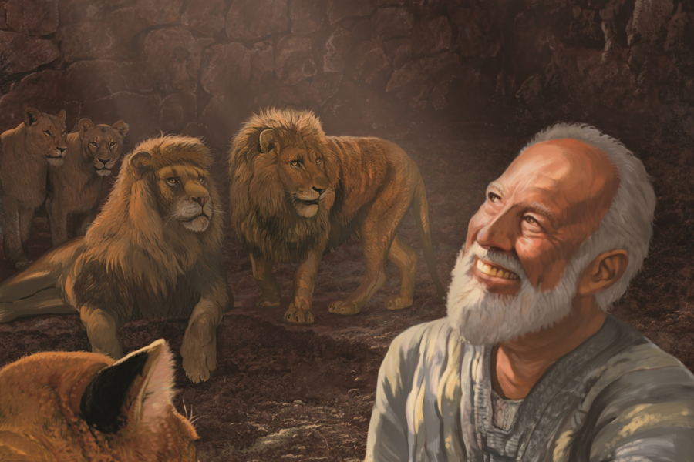
There are other arguments put forward
by skeptics of the Book of Daniel?
Resource: bs.newtownbredagospelhall.com
The Authenticity of the Book of Daniel: A Survey of the Evidence
July 14, 2021 (40 Pages)

Slide 102
There are other arguments put forward
by skeptics of the Book of Daniel?
Resource: bs.newtownbredagospelhall.com
The Authenticity of the Book of Daniel: A Survey of the Evidence
July 14, 2021
The document titled "The Authenticity of the Book of Daniel" discusses the debate over the dating of the biblical book of Daniel. It addresses the challenges to the traditional dating of the book and presents arguments for both early and late dating. The text examines linguistic, historical, and theological evidence to support the traditional dating of Daniel to the sixth century. It also highlights the presence of Greek words in the book and their implications for dating. The document concludes by acknowledging that while there are outstanding problems and questions,
the evidence leans more towards a traditional sixth century dating of Daniel.

Slide 103
What are some of the arguments put forward
in support of the authenticity of the Book of Daniel?
Historical Accuracy:
Conservative apologists often highlight the historical accuracy of the book.
They point to specific details such as the description of the palace walls
in Babylon, which archaeological excavations have confirmed.
Fulfillment of Prophecies:
The fulfillment of prophecies in the book supports its authenticity.
For example, the book's predictions about the rise and fall of various kingdoms
are seen as evidence of its divine inspiration.
Role of Nebuchadnezzar:
Some apologists emphasize the portrayal of Nebuchadnezzar as a significant historical figure,
which they argue aligns with historical records and supports the book's authenticity.
Consistency of the Text:
They also point to the unity and coherence of the book, arguing that it demonstrates
a single authorship and a consistent purpose, which they believe supports its authenticity.
Use by Jesus:
The fact that Jesus recognized the book of Daniel as having Scriptural authority
is often cited as evidence in support of its authenticity.
These arguments are used to support the traditional dating of Daniel and to counter challenges to its authenticity.

Slide 104
Babylonian
Medes
and Persians
Greece
Roman
Empire
Final kingdom
of the Gentiles
God told Daniel
in 606 BC
what was to come after Nebuchadnezzar
began 608 bc
began 539 bc
began 334 bc
began 27 bc
?
The Medes, Persians, Greeks and Romans were all in the future
If what Daniel wrote about his near future became true
so will what he wrote about the far future

Slide 105
The end times
Babylonian
Medes
and Persians
Greece
Roman
Empire
Final kingdom
of the Gentiles
God told Daniel
in 606 BC
what was to come after Nebuchadnezzar
began 608 bc
began 539 bc
began 334 bc
began 27 bc
?
The Medes, Persians, Greeks and Romans were all in the future
If what Daniel wrote about his near future became true
so will what he wrote about the far future

Slide 106
Things to come
Let us consider this
last kingdom of men
Law |  |  |  | Grace | Kingdom
Babylonian | Medes & Persians | Greece | Rome |  | Last
608 bc |  |  |  | 0 | ?AD
 |  |  |  | Christ | Kingdom
Babylon
Thou art this
head of gold!
Daniel 2v38
Medes & Persians
So this Daniel prospered in the reign of Darius, and in the reign of Cyrus the Persian.
Daniel 6v28
Greece
…when I am gone forth, lo, the prince of Grecia shall come.
Daniel 10v20
Rome
Now in the fifteenth year of the reign of Tiberius Caesar
Luke 3v1
Last Kingdom
of men
the kingdom shall be divided;
Daniel 2v41

Slide 107
Things to come
Law |  |  |  | Grace | Kingdom
Babylonian | Medes & Persians | Greece | Rome |  | Last
608 bc |  |  |  | 0 | ?AD
 |  |  |  | Christ | Kingdom
You might think that the Bible predicted that this last kingdom would follow immediately after the fall of Rome!
Last Kingdom
of men
the kingdom shall be divided;
Daniel 2v41

Slide 108
Things to come
Law |  |  |  |  | Kingdom
Babylonian | Medes & Persians | Greece | Rome |  | Last
608 bc |  |  |  | 0 | ?AD
 |  |  |  | Christ | Kingdom
But remember that there is a dispensation that was not revealed in the Old Testament which comes in between
the Law and the Kingdom
Last Kingdom
of men
the kingdom shall be divided;
Daniel 2v41

Slide 109
Things to come
Innocence | Conscience | Human Government | Promise | Law | Grace | Kingdom
? | 4000BC | 2500BC | 2000BC | 1500BC | 0 | ?AD
Garden | The Fall | The Flood | Abraham | Moses | Christ | Kingdom
The dispensation of Grace
or of the church age
where we are living,
is introduced in the New Testament
between the Law and the Kingdom.

Slide 110
Things to come
Innocence | Conscience | Human Government | Promise | Law | Grace | Kingdom
? | 4000BC | 2500BC | 2000BC | 1500BC | 0 | ?AD
Garden | The Fall | The Flood | Abraham | Moses | Christ | Kingdom
The dispensation of Grace
or of the church age
where we are living,
is introduced in the New Testament
between the Law and the Kingdom.

Slide 111
Things to come
608 BC
476 AD
Law |  |  |  | Grace | Kingdom
Babylonian | Medes & Persians | Greece | Rome |  | Last
608 bc |  |  |  | 0 | ?AD
 |  |  |  | Christ | Kingdom

Slide 112
Things to come
There is a gap between the fall of Rome and the final kingdom of men.
in other words, between the ankles and the feet
608 BC
476 AD
Law |  |  |  | Grace | Kingdom
Babylonian | Medes & Persians | Greece | Rome |  | Last
608 bc |  |  |  | 0 | ?AD
 |  |  |  | Christ | Kingdom

Slide 113
Things to come
Grace
608 bc
Law |  |  |  | Grace | Kingdom
Babylonian | Medes & Persians | Greece | Rome |  | Last
608 bc |  |  |  | 0 | ?AD
 |  |  |  | Christ | Kingdom
The dispensation of Grace
or of the church age
where we are living,
is introduced in the New Testament
between the Law and the Kingdom.

Slide 114
Things to come
The final and last kingdom of men
will only happen after the church age,
when the dispensation of grace finishes
Grace
608 bc
Law |  |  |  | Grace | Kingdom
Babylonian | Medes & Persians | Greece | Rome |  | Last
608 bc |  |  |  | 0 | ?AD
 |  |  |  | Christ | Kingdom
The dispensation of Grace
or of the church age
where we are living
is introduced in the New Testament
between the Law and the Kingdom.

Slide 115
Things to come
Grace
Are there any scriptures in the OT
that reference this gap?
608 bc
Law |  |  |  | Grace | Kingdom
Babylonian | Medes & Persians | Greece | Rome |  | Last
608 bc |  |  |  | 0 | ?AD
 |  |  |  | Christ | Kingdom

Slide 116
Things to come
Daniel 9:24-27
Seventy weeks are determined upon thy people and upon thy holy city.
²⁵ Know therefore and understand, that from the going forth of the commandment to restore and to build Jerusalem unto the Messiah the Prince shall be seven weeks and threescore and two weeks (69 weeks) the street shall be built again, and the wall, even in troublous times (during the 7 weeks)
²⁶ And after threescore and two weeks (7 + 62 = 69 weeks) shall Messiah be cut off and the people of the prince that shall come shall destroy the city
²⁷ And he shall confirm the covenant with many for one week (7 Years):
and in the midst of the week (after 3.5 years) he shall cause the sacrifice and the oblation to cease
Grace
608 bc
Law |  |  |  | Grace | Kingdom
Babylonian | Medes & Persians | Greece | Rome |  | Last
608 bc |  |  |  | 0 | ?AD
 |  |  |  | Christ | Kingdom

Slide 117
Things to come
608 bc
After 69 weeks until Messiah was cut off
7 Yrs
Law |  |  |  | Grace | Kingdom
Babylonian | Medes & Persians | Greece | Rome |  | Last
608 bc |  |  |  | 0 | ?AD
 |  |  |  | Christ | Kingdom
445 BC
Nehemiah was given permission
to rebuild the walls of Jerusalem
in 445 BC

Slide 118
Things to come
608 bc
After 69 weeks until Messiah was cut off
7 Yrs
Law |  |  |  | Grace | Kingdom
Babylonian | Medes & Persians | Greece | Rome |  | Last
608 bc |  |  |  | 0 | ?AD
 |  |  |  | Christ | Kingdom
445 BC
69 weeks is just over a year
This clearly does not work!

Slide 119
Things to come
608 bc
After 69 weeks until Messiah was cut off
7 Yrs
Law |  |  |  | Grace | Kingdom
Babylonian | Medes & Persians | Greece | Rome |  | Last
608 bc |  |  |  | 0 | ?AD
 |  |  |  | Christ | Kingdom
445 BC
However instead of weeks of days they are weeks of years
1 week = 7 years not 7 days!

Slide 120
Things to come
608 bc
After 69 weeks until Messiah was cut off
7 Yrs
Law |  |  |  | Grace | Kingdom
Babylonian | Medes & Persians | Greece | Rome |  | Last
608 bc |  |  |  | 0 | ?AD
 |  |  |  | Christ | Kingdom
445 BC
(Weeks of years)
69 x 7 = 483 years
483 years
- 445 years
38 --------- this would put the death of Christ at 38 AD

Slide 121
Things to come
608 bc
After 69 weeks until Messiah was cut off
7 Yrs
Law |  |  |  | Grace | Kingdom
Babylonian | Medes & Persians | Greece | Rome |  | Last
608 bc |  |  |  | 0 | ?AD
 |  |  |  | Christ | Kingdom
445 BC
However, a prophetic year had only 360 days not 365.25 : Rev 11v3
(69 X 7) X 360 / 365.25 = 476.06 years
476.06 years
- 445.00 years
31.06 --------- this would put the death of Christ at 32 AD

Slide 122
Things to come
608 bc
After 69 weeks until Messiah was cut off
7 Yrs
Law |  |  |  | Grace | Kingdom
Babylonian | Medes & Persians | Greece | Rome |  | Last
608 bc |  |  |  | 0 | ?AD
 |  |  |  | Christ | Kingdom
445 BC
However, a prophetic year had only 360 days not 365.25 : Rev 11v3
(69 X 7) X 360 / 365.25 = 476.06 years
476.06 years
- 445.00 years
31.06 --------- this would put the death of Christ at 32 AD
32 AD?

Slide 123
Things to come
Daniel 2:41-45
And as the toes of the feet were part of iron, and part of clay, so the kingdom shall be partly strong, and partly broken. And whereas thou sawest iron mixed with miry clay, they shall mingle themselves with the seed of men: but they shall not cleave one to another, even as iron is not mixed with clay.
⁴⁴ And in the days of these kings shall the God of heaven set up a kingdom, which shall never be destroyed: and the kingdom shall not be left to other people, but it shall break in pieces and consume all these kingdoms, and it shall stand for ever.
608 bc
69 weeks until Messiah was cut off– (483 years)
7 Yrs
Law |  |  |  | Grace | Kingdom
Babylonian | Medes & Persians | Greece | Rome |  | Last
608 bc |  |  |  | 0 | ?AD
 |  |  |  | Christ | Kingdom
445 BC
32 AD

Slide 124
Things to come
The final kingdom of men will only last for 7 years and shall be destroyed.
and then God will set up a Kingdom
which will never be destroyed
God’s Kingdom will follow
the destruction of the final kingdom of men!
608 bc
69 weeks until Messiah was cut off– (483 years)
7 Yrs
Law |  |  |  | Grace | Kingdom
Babylonian | Medes & Persians | Greece | Rome |  | Last
608 bc |  |  |  | 0 | ?AD
 |  |  |  | Christ | Kingdom
445 BC
32 AD

