Slide 1
Bible Study
1st Peter

Slide 2
1 Peter 5:5-7(KJV)
⁵ Likewise, ye younger, submit yourselves unto the elder. Yea, all of you be subject one to another, and be clothed with humility: for God resisteth the proud, and giveth grace to the humble.
⁶ Humble yourselves therefore under the mighty hand of God, that he may exalt you in due time:
⁷ Casting all your care upon him; for he careth for you.

Slide 3
1 Peter 5:5-7 (KJV) (ESV)
⁵ Likewise, ye younger, submit yourselves unto the elder. Yea, all of you be subject one to another, and be clothed with humility: for God resisteth the proud, and giveth grace to the humble.
⁶ Humble yourselves therefore under the mighty hand of God, that he may exalt you in due time:
⁷ Casting all your care upon him; for he careth for you.
ESV
⁵ Likewise, you who are younger, be subject to the elders. Clothe yourselves, all of you, with humility toward one another, for “God opposes the proud but gives grace to the humble.” ⁶ Humble yourselves, therefore, under the mighty hand of God so that at the proper time he may exalt you, ⁷ casting all your anxieties on him, because he cares for you. 1 Peter 5:4-7

Slide 4
1 Peter 5:5-7
Likewise, ye younger, submit yourselves unto the elder.
Yea, all of you be subject one to another, and be clothed with humility: for God resisteth the proud, and giveth grace to the humble.
Humble yourselves therefore under the mighty hand of God, that he may exalt you in due time:
Casting all your care upon him; for he careth for you.

Slide 5
1 Peter 5:5-7
Likewise, ye younger, submit yourselves unto the elder.
Having addressed the elders
Peter now turns to the flock.

Slide 6
1 Peter 5:5-7
Likewise, ye younger, submit yourselves unto the elder.
In particular those who are younger!

Slide 7
1 Peter 5:5-7
Likewise, ye younger, submit yourselves unto the elder.
He tells them to obey
and be subject to the elders.

Slide 8
1 Peter 5:5-7
Likewise, ye younger, submit yourselves unto the elder.
Why does he press this?
Why wouldn’t they submit?
He tells them to obey
and be subject to the elders.

Slide 9
1 Peter 5:5-7
Likewise, ye younger, submit yourselves unto the elder.
Yea, all of you be subject one to another, and be clothed with humility:
for God resisteth the proud, and giveth grace to the humble.
Peter identifies
the problem

Slide 10
1 Peter 5:5-7
Likewise, ye younger, submit yourselves unto the elder.
Yea, all of you be subject one to another, and be clothed with humility:
for God resisteth the proud, and giveth grace to the humble.
Pride

Slide 11
1 Peter 5:5-7
Peter speaks on the subject of pride
How serious it is
How to overcome it
Pride

Slide 12
1 Peter 5:5-7
Likewise, ye younger, submit yourselves unto the elder.
Yea, all of you be subject one to another, and be clothed with humility:
for God resisteth the proud, and giveth grace to the humble.
Humble yourselves therefore under the mighty hand of God,
that he may exalt you in due time:
Casting all your care upon him; for he careth for you.
Pride can be summarized as an attitude of:
self-sufficiency

Slide 13
1 Peter 5:5-7
Likewise, ye younger, submit yourselves unto the elder.
Yea, all of you be subject one to another, and be clothed with humility:
for God resisteth the proud, and giveth grace to the humble.
Humble yourselves therefore under the mighty hand of God,
that he may exalt you in due time:
Casting all your care upon him; for he careth for you.
Pride can be summarized as an attitude of:
self-sufficiency I don’t want anyone else

Slide 14
1 Peter 5:5-7
Likewise, ye younger, submit yourselves unto the elder.
Yea, all of you be subject one to another, and be clothed with humility:
for God resisteth the proud, and giveth grace to the humble.
Humble yourselves therefore under the mighty hand of God,
that he may exalt you in due time:
Casting all your care upon him; for he careth for you.
Pride can be summarized as an attitude of:
self-sufficiency I don’t want anyone else
self-importance

Slide 15
1 Peter 5:5-7
Likewise, ye younger, submit yourselves unto the elder.
Yea, all of you be subject one to another, and be clothed with humility:
for God resisteth the proud, and giveth grace to the humble.
Humble yourselves therefore under the mighty hand of God,
that he may exalt you in due time:
Casting all your care upon him; for he careth for you.
Pride can be summarized as an attitude of:
self-sufficiency I don’t want anyone else
self-importance I don’t need anyone else

Slide 16
1 Peter 5:5-7
Likewise, ye younger, submit yourselves unto the elder.
Yea, all of you be subject one to another, and be clothed with humility:
for God resisteth the proud, and giveth grace to the humble.
Humble yourselves therefore under the mighty hand of God,
that he may exalt you in due time:
Casting all your care upon him; for he careth for you.
Pride can be summarized as an attitude of:
self-sufficiency I don’t want anyone else
self-importance I don’t need anyone else
self-exaltation

Slide 17
1 Peter 5:5-7
Likewise, ye younger, submit yourselves unto the elder.
Yea, all of you be subject one to another, and be clothed with humility:
for God resisteth the proud, and giveth grace to the humble.
Humble yourselves therefore under the mighty hand of God,
that he may exalt you in due time:
Casting all your care upon him; for he careth for you.
Pride can be summarized as an attitude of:
self-sufficiency I don’t want anyone else
self-importance I don’t need anyone else
self-exaltation I don’t appreciate anyone else

Slide 18
1 Peter 5:5-7
Likewise, ye younger, submit yourselves unto the elder.
Yea, all of you be subject one to another, and be clothed with humility:
for God resisteth the proud, and giveth grace to the humble.
Humble yourselves therefore under the mighty hand of God,
that he may exalt you in due time:
Casting all your care upon him; for he careth for you.
Pride can be summarized as an attitude of:
self-sufficiency I don’t want anyone else
self-importance I don’t need anyone else
self-exaltation I don’t appreciate anyone else
and results in:
contempt and indifference toward others

Slide 19
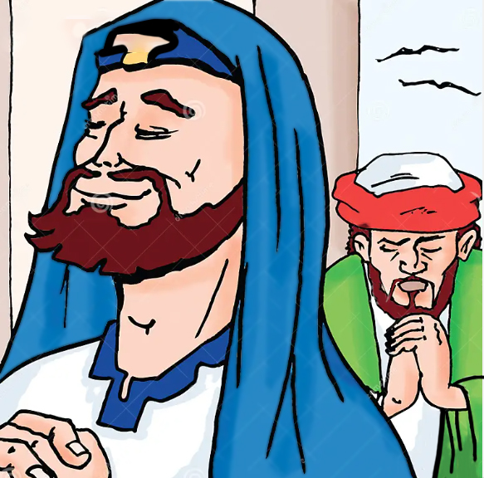
1 Peter 5:5-7
Likewise, ye younger, submit yourselves unto the elder.
Yea, all of you be subject one to another, and be clothed with humility:
for God resisteth the proud, and giveth grace to the humble.
Humble yourselves therefore under the mighty hand of God,
that he may exalt you in due time:
Casting all your care upon him; for he careth for you.
There is a great example of this
Luke ch.18
The pharisee and the publican!
for every one that exalteth himself
shall be abased;
and he that humbleth himself
shall be exalted.
Luke 18:14

Slide 20
1 Peter 5:5-7
Likewise, ye younger, submit yourselves unto the elder.
Yea, all of you be subject one to another, and be clothed with humility:
for God resisteth the proud, and giveth grace to the humble.
Humble yourselves therefore under the mighty hand of God,
that he may exalt you in due time:
Casting all your care upon him; for he careth for you.
God is against pride!
Every one that is proud in heart
is an abomination to the LORD
Proverbs 16:5
Pride provokes God’s displeasure,
He has committed himself to oppose it.

Slide 21
1 Peter 5:5-7
⁵ Likewise, ye younger, submit yourselves unto the elder.
Yea, all of you be subject one to another, and be clothed with humility:
for God resisteth the proud, and giveth grace to the humble.
The word ‘resisteth’ is a military term
meaning ‘to set yourself in battle against’

Slide 22
1 Peter 5:5-7
Likewise, ye younger, submit yourselves unto the elder.
Yea, all of you be subject one to another, and be clothed with humility:
for God resisteth the proud, and giveth grace to the humble.
Humble yourselves therefore under the mighty hand of God,
that he may exalt you in due time:
Casting all your care upon him; for he careth for you.
C.S. Lewis wrote: (Mere Christianity)
If your pride causes you to exalt yourself,
you are painting a target on your back
and inviting God to open fire!

Slide 23
1 Peter 5:5-7
Likewise, ye younger, submit yourselves unto the elder.
Yea, all of you be subject one to another, and be clothed with humility:
for God resisteth the proud, and giveth grace to the humble.
Humble yourselves therefore under the mighty hand of God,
that he may exalt you in due time:
Casting all your care upon him; for he careth for you.
Pride is serious but there is an antidote!
Humility.

Slide 24
1 Peter 5:5-7
Likewise, ye younger, submit yourselves unto the elder.
Yea, all of you be subject one to another, and be clothed with humility:
for God resisteth the proud, and giveth grace to the humble.
Humble yourselves therefore under the mighty hand of God,
that he may exalt you in due time:
Casting all your care upon him; for he careth for you.
Pride is serious but there is an antidote!
Humility.

Slide 25
1 Peter 5:5-7
Likewise, ye younger, submit yourselves unto the elder.
Yea, all of you be subject one to another, and be clothed with humility:
for God resisteth the proud, and giveth grace to the humble.
Humble yourselves therefore under the mighty hand of God,
that he may exalt you in due time:
Casting all your care upon him; for he careth for you.
Pride and Humility are complete opposites

Slide 26
1 Peter 5:5-7
Likewise, ye younger, submit yourselves unto the elder.
Yea, all of you be subject one to another, and be clothed with humility:
for God resisteth the proud, and giveth grace to the humble.
Humble yourselves therefore under the mighty hand of God,
that he may exalt you in due time:
Casting all your care upon him; for he careth for you.
If you fill yourself with pride
you push humility out
If you fill yourself with humility
you push pride out

Slide 27
The greatest example of pride
The greatest example of humility

Slide 28
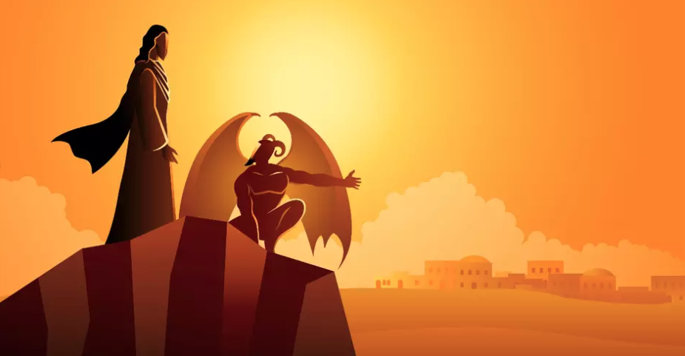
The greatest example of pride is the devil
The greatest example of humility is Christ

Slide 29
The greatest example of pride is the devil
The greatest example of humility is Christ
There could not be 2 things further apart
than Satan and Christ?

Slide 30
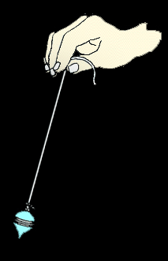
The more pride
we have
the more like Satan we are
The more humility
we have
the more like Christ we are
Pride
Humility

Slide 31
We are not trying to find a happy medium
We want to be completely rid of pride
and be filled with humility
The more pride
we have
the more like Satan we are
The more humility
we have
the more like Christ we are
Pride
Humility

Slide 32
1 Peter 5:5-7
⁵ Likewise, ye younger, submit yourselves unto the elder.
Yea, all of you be subject one to another, and be clothed with humility:
for God resisteth the proud, and giveth grace to the humble.
Peter’s word is:
be clothed with humility

Slide 33
1 Peter 5:5-7
⁵ Likewise, ye younger, submit yourselves unto the elder.
Yea, all of you be subject one to another, and be clothed with humility:
for God resisteth the proud, and giveth grace to the humble.
We get the idea from the words that Peter uses
that he knows what he is talking about.

Slide 34
1 Peter 5:5-7
⁵ Likewise, ye younger, submit yourselves unto the elder.
Yea, all of you be subject one to another, and be clothed with humility:
for God resisteth the proud, and giveth grace to the humble.
He is remembering back
to the experiences he had
and was taught by in the Gospels

Slide 35
1 Peter 5:5-7
⁵ Likewise, ye younger, submit yourselves unto the elder.
Yea, all of you be subject one to another, and be clothed with humility:
for God resisteth the proud, and giveth grace to the humble.
John 21:18
Verily, verily, I say to you,
when you were younger, you girded yourself
and walked where you wished;
(but things changed as he got older)

Slide 36
1 Peter 5:5-7
⁵ Likewise, ye younger, submit yourselves unto the elder.
Yea, all of you be subject one to another, and be clothed with humility:
for God resisteth the proud, and giveth grace to the humble.
Matthew 26:33-35
Peter answered and said unto him,
though all men shall be offended because of thee,
yet will I never be offended.
…though I should die with thee,
yet will I not deny thee

Slide 37
1 Peter 5:5-7
⁵ Likewise, ye younger, submit yourselves unto the elder.
Yea, all of you be subject one to another, and be clothed with humility:
for God resisteth the proud, and giveth grace to the humble.
John 13:4-5
Jesus riseth from supper, and laid aside his garments;
and took a towel, and girded himself.
after that he poureth water into a bason,
and began to wash the disciples' feet

Slide 38
1 Peter 5:5-7
⁵ Likewise, ye younger, submit yourselves unto the elder.
Yea, all of you be subject one to another, and be clothed with humility:
for God resisteth the proud, and giveth grace to the humble.
Luke 22:31-32
And the Lord said, Simon, Simon, behold,
Satan hath desired to have you, that he may sift you as wheat:
But I have prayed for thee, that thy faith fail not:
and when thou art converted, strengthen thy brethren.

Slide 39
1 Peter 5:5-7
Likewise, ye younger, submit yourselves unto the elder.
Yea, all of you be subject one to another, and be clothed with humility:
for God resisteth the proud, and giveth grace to the humble.
Humble yourselves therefore under the mighty hand of God,
that he may exalt you in due time:
Casting all your care upon him; for he careth for you.
The antidote to pride is humility

Slide 40
1 Peter 5:5-7
Likewise, ye younger, submit yourselves unto the elder.
Yea, all of you be subject one to another, and be clothed with humility:
for God resisteth the proud, and giveth grace to the humble.
Humble yourselves therefore under the mighty hand of God,
that he may exalt you in due time:
The antidote to pride is humility

Slide 41
1 Peter 5:5-7
Likewise, ye younger, submit yourselves unto the elder.
Yea, all of you be subject one to another, and be clothed with humility:
for God resisteth the proud, and giveth grace to the humble.
Humble yourselves therefore under the mighty hand of God,
that he may exalt you in due time:
Luke 14v11
For whosoever exalteth himself shall be abased;
and he that humbleth himself shall be exalted.
There are examples of those who exalted themselves
but were brought down by God
The antidote to pride is humility

Slide 42
Who said this:
Is not this the great Babylon which I have built?

Slide 43
Who said this:
Is not this the great Babylon which I have built?
Nebuchadnezzar: Daniel 4v30

Slide 44
Who said this:
Is not this the great Babylon which I have built?
Nebuchadnezzar: Daniel 4v30
While the word was in the king's mouth, there fell a voice from heaven, saying,
O king Nebuchadnezzar, to thee it is spoken; The kingdom is departed from thee.
and they shall drive thee from men, and thy dwelling shall be with the beasts of the field:
Daniel 4:31-32

Slide 45
Who said this:
Is not this the great Babylon which I have built?
Nebuchadnezzar: Daniel 4v30
It is the voice of a god, and not of a man!

Slide 46
Who said this:
Is not this the great Babylon which I have built?
Nebuchadnezzar: Daniel 4v30
It is the voice of a god, and not of a man!
The people of Tyre and sidon speaking of King Herod: Acts 12:22-23

Slide 47
Who said this:
Is not this the great Babylon which I have built?
Nebuchadnezzar: Daniel 4v30
It is the voice of a god, and not of a man!
The people of Tyre and sidon speaking of King Herod: Acts 12:22-23
And immediately the angel of the Lord smote him, because he gave not God the glory: and he was eaten of worms, and gave up the ghost.
Acts 12:23

Slide 48
Who said this:
Is not this the great Babylon which I have built?
Nebuchadnezzar: Daniel 4v30
It is the voice of a god, and not of a man!
The people of Tyre and sidon speaking of King Herod: Acts 12:22-23
Who is David? and who is the son of Jesse?
Shall I then take my bread, and my water and give it unto him?

Slide 49
Who said this:
Is not this the great Babylon which I have built?
Nebuchadnezzar: Daniel 4v30
It is the voice of a god, and not of a man!
The people of Tyre and sidon speaking of King Herod: Acts 12:22-23
Who is David? and who is the son of Jesse?
Shall I then take my bread, and my water and give it unto him?
Nabal: 1 Samuel 25:10-11

Slide 50
Who said this:
Is not this the great Babylon which I have built?
Nebuchadnezzar: Daniel 4v30
It is the voice of a god, and not of a man!
The people of Tyre and sidon speaking of King Herod: Acts 12:22-23
Who is David? and who is the son of Jesse?
Shall I then take my bread, and my water and give it unto him?
Nabal: 1 Samuel 25:10-11
But it came to pass in the morning, when the wine was gone out of Nabal, and his wife had told him these things, that his heart died within him, and he became as a stone. And it came to pass about ten days after, that the LORD smote Nabal, that he died.
1 Samuel 25:37-38

Slide 51
Who said this:
Is not this the great Babylon which I have built?
Nebuchadnezzar: Daniel 4v30
It is the voice of a god, and not of a man!
The people of Tyre and sidon speaking of King Herod: Acts 12:22-23
Who is David? and who is the son of Jesse?
Shall I then take my bread, and my water and give it unto him?
Nabal: 1 Samuel 25:10-11
Let us make us a name, lest we be scattered abroad?

Slide 52
Who said this:
Is not this the great Babylon which I have built?
Nebuchadnezzar: Daniel 4v30
It is the voice of a god, and not of a man!
The people of Tyre and sidon speaking of King Herod: Acts 12:22-23
Who is David? and who is the son of Jesse?
Shall I then take my bread, and my water and give it unto him?
Nabal: 1 Samuel 25:10-11
Let us make us a name, lest we be scattered abroad?
Men of Babel: Genesis 11:4-5

Slide 53
Who said this:
Is not this the great Babylon which I have built?
Nebuchadnezzar: Daniel 4v30
It is the voice of a god, and not of a man!
The people of Tyre and sidon speaking of King Herod: Acts 12:22-23
Who is David? and who is the son of Jesse?
Shall I then take my bread, and my water and give it unto him?
Nabal: 1 Samuel 25:10-11
Let us make us a name, lest we be scattered abroad?
Men of Babel: Genesis 11:4-5
So the LORD scattered them abroad from thence upon the face of all the earth: and they left off to build the city. Therefore is the name of it called Babel; because the LORD did there confound the language of all the earth: and from thence did the LORD scatter them abroad upon the face of all the earth.
Genesis 11:8-9

Slide 54
Who said this:
Is not this the great Babylon which I have built?
Nebuchadnezzar: Daniel 4v30
It is the voice of a god, and not of a man!
The people of Tyre and sidon speaking of King Herod: Acts 12:22-23
Who is David? and who is the son of Jesse?
Shall I then take my bread, and my water and give it unto him?
Nabal: 1 Samuel 25:10-11
Let us make us a name, lest we be scattered abroad?
Men of Babel: Genesis 11:4-5
I thank thee, that I am not as other men:

Slide 55
Who said this:
Is not this the great Babylon which I have built?
Nebuchadnezzar: Daniel 4v30
It is the voice of a god, and not of a man!
The people of Tyre and sidon speaking of King Herod: Acts 12:22-23
Who is David? and who is the son of Jesse?
Shall I then take my bread, and my water and give it unto him?
Nabal: 1 Samuel 25:10-11
Let us make us a name, lest we be scattered abroad?
Men of Babel: Genesis 11:4-5
I thank thee, that I am not as other men: The Pharisee: Luke 18:11

Slide 56
Who said this:
Is not this the great Babylon which I have built?
Nebuchadnezzar: Daniel 4v30
It is the voice of a god, and not of a man!
The people of Tyre and sidon speaking of King Herod: Acts 12:22-23
Who is David? and who is the son of Jesse?
Shall I then take my bread, and my water and give it unto him?
Nabal: 1 Samuel 25:10-11
Let us make us a name, lest we be scattered abroad?
Men of Babel: Genesis 11:4-5
I thank thee, that I am not as other men: The Pharisee: Luke 18:11
I tell you, this man (the publican)
went down to his house justified rather than the other: (the Pharisee)
Luke 18:14

Slide 57
1 Peter 5:5-7
Likewise, ye younger, submit yourselves unto the elder.
Yea, all of you be subject one to another, and be clothed with humility:
for God resisteth the proud, and giveth grace to the humble.
Humble yourselves therefore under the mighty hand of God,
that he may exalt you in due time:
Casting all your care upon him; for he careth for you.
Fighting pride within is not easy!
Humility is not valued by the world
It is looked upon as weakness

Slide 58
1 Peter 5:5-7
Likewise, ye younger, submit yourselves unto the elder.
Yea, all of you be subject one to another, and be clothed with humility:
for God resisteth the proud, and giveth grace to the humble.
Humble yourselves therefore under the mighty hand of God,
that he may exalt you in due time:
Casting all your care upon him; for he careth for you.
Showing humility
can make you feel
vulnerable and anxious

Slide 59
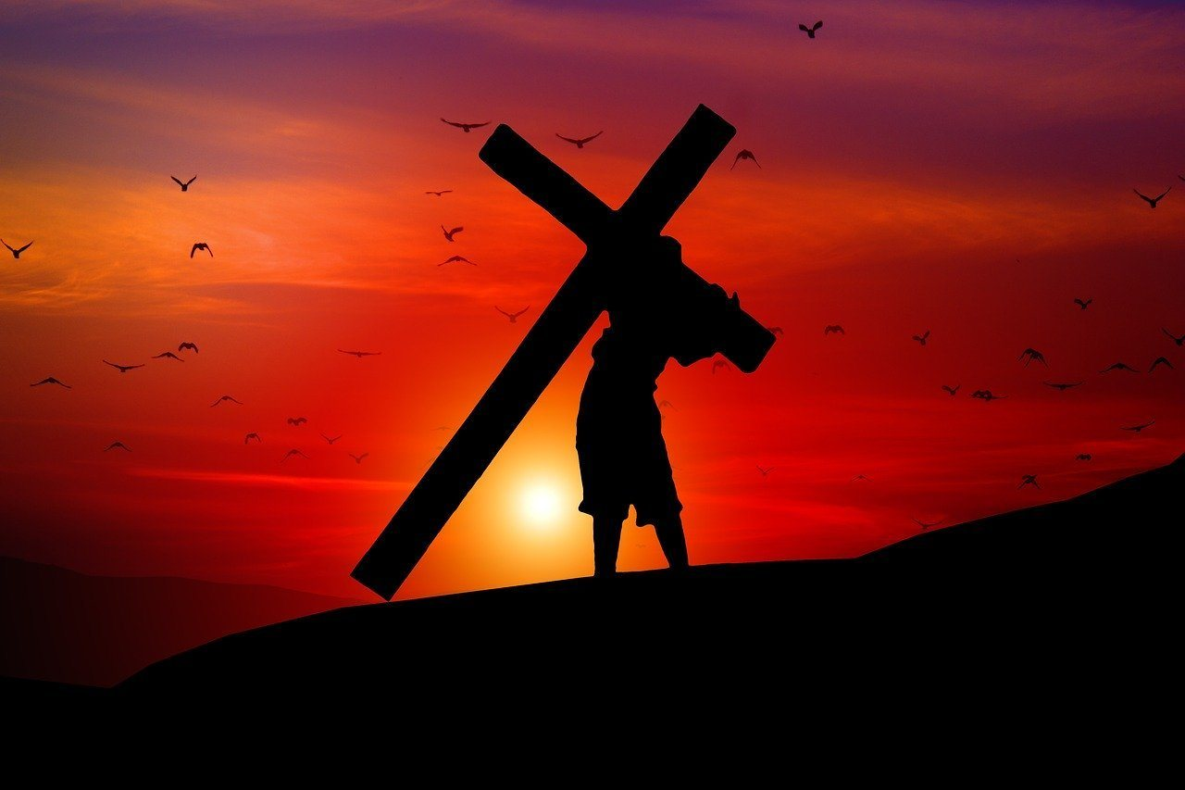
1 Peter 5:5-7
Casting all your care upon him; for he careth for you.
Peter reminds his readers
(and us of course)
that no matter who is against you
God is for you!

Slide 60
1 Peter 5:5-7
Casting all your care upon him; for he careth for you.
We have anxious thoughts
He has loving care

Slide 61
Proverbs has a lot to say about pride:
Proverbs 16v5: Every one that is proud in heart
is an abomination to the LORD:
Proverbs 16v18: Pride goeth before destruction, and an haughty spirit before a fall.
Proverbs 16v19: Better it is to be of an humble spirit with the lowly, than to divide the spoil with the proud.
Proverbs 28v25: He that is of a proud heart stirreth up strife:
Proverbs 6v16-17: Six things doth the LORD hate: yea, seven are an abomination unto him: A proud look, a lying tongue….

Slide 62
There are many verses about Humility:
2 Chronicles 7v14: If my people, which are called by my name,
shall humble themselves, and pray… then will I hear from heaven
Psalm 9v12: He remembereth them: he forgetteth not the cry of the humble.
Isaiah 57v15: For thus saith the high and lofty One that inhabiteth eternity,
whose name is Holy; I dwell in the high and holy place, with him also that is of a contrite and humble spirit,
Matthew 18v4: Whosoever therefore shall humble himself as this little child,
the same is greatest in the kingdom of heaven.
Matthew 23v12: And whosoever shall exalt himself shall be abased;
and he that shall humble himself shall be exalted.

