Slide 1
Bible Study
1st Peter

Slide 2
1 Peter 5:10-14
¹⁰ But the God of all grace, who hath called us unto his eternal glory by Christ Jesus, after that ye have suffered a while, make you perfect, stablish, strengthen, settle you.
¹¹ To him be glory and dominion for ever and ever. Amen.
¹² By Silvanus, a faithful brother unto you, as I suppose, I have written briefly, exhorting, and testifying that this is the true grace of God wherein ye stand.
¹³ The church that is at Babylon, elected together with you, saluteth you; and so doth Marcus my son.
¹⁴ Greet ye one another with a kiss of charity. Peace be with you all that are in Christ Jesus.
Amen.

Slide 3
1 Peter 5:10-14
¹⁰ But the God of all grace,
who hath called us unto his eternal glory by Christ Jesus,
after that ye have suffered a while,
make you perfect, stablish, strengthen, settle you.
¹¹ To him be glory and dominion for ever and ever. Amen.
¹² By Silvanus, a faithful brother unto you, as I suppose,
I have written briefly, exhorting, and testifying that this is the true grace of God wherein ye stand.
¹³ The church that is at Babylon, elected together with you, saluteth you;
and so doth Marcus my son.
¹⁴ Greet ye one another with a kiss of charity.
Peace be with you all that are in Christ Jesus.
Amen.

Slide 4
1 Peter 5:10
¹⁰ But the God of all grace,
who hath called us unto his eternal glory by Christ Jesus,
after that ye have suffered a while,
make you perfect, stablish, strengthen, settle you.

Slide 5
1 Peter 5:10
Be sober, be vigilant; because your adversary the devil,
as a roaring lion, walketh about, seeking whom he may devour:
Whom resist stedfast in the faith, knowing that
the same afflictions are accomplished in your brethren that are in the world.
¹⁰ But the God of all grace,
who hath called us unto his eternal glory by Christ Jesus,
after that ye have suffered a while,
make you perfect, stablish, strengthen, settle you.
This last section comes immediately after
describing their enemy the devil

Slide 6
1 Peter 5:8-14
Be sober, be vigilant; because your adversary the devil,
as a roaring lion, walketh about, seeking whom he may devour:
Whom resist stedfast in the faith, knowing that
the same afflictions are accomplished in your brethren that are in the world.
¹⁰ But the God of all grace,
who hath called us unto his eternal glory by Christ Jesus,
after that ye have suffered a while,
make you perfect, stablish, strengthen, settle you.
¹¹ To him be glory and dominion for ever and ever. Amen.
As Peter closes his letter
we are reminded of all the difficulties
that the saints were going though.
Peter leaves them with something
to focus on and to look forward to
This last section comes immediately after
describing their enemy the devil

Slide 7
In the previous 4 chapters Peter has spoken of their difficulties

Slide 8
In the previous 4 chapters Peter has spoken of their difficulties
They were scattered and had become strangers and pilgrims – ch.1

Slide 9
In the previous 4 chapters Peter has spoken of their difficulties
They were scattered and had become strangers and pilgrims – ch.1
They were in heaviness through manifold temptations – ch.1

Slide 10
In the previous 4 chapters Peter has spoken of their difficulties
They were scattered and had become strangers and pilgrims – ch.1
They were in heaviness through manifold temptations – ch.1
They were called evildoers by their neighbours – ch.2

Slide 11
In the previous 4 chapters Peter has spoken of their difficulties
They were scattered and had become strangers and pilgrims – ch.1
They were in heaviness through manifold temptations – ch.1
They were called evildoers by their neighbours – ch.2
They were suffering for righteousness' sake – ch.2

Slide 12
In the previous 4 chapters Peter has spoken of their difficulties
They were scattered and had become strangers and pilgrims – ch.1
They were in heaviness through manifold temptations – ch.1
They were called evildoers by their neighbours – ch.2
They were suffering for righteousness' sake – ch.2
They were suffering for well doing – ch.3

Slide 13
In the previous 4 chapters Peter has spoken of their difficulties
They were scattered and had become strangers and pilgrims – ch.1
They were in heaviness through manifold temptations – ch.1
They were called evildoers by their neighbours – ch.2
They were suffering for righteousness' sake – ch.2
They were suffering for well doing – ch.3
They were spoken evil of – ch.3

Slide 14
In the previous 4 chapters Peter has spoken of their difficulties
They were scattered and had become strangers and pilgrims – ch.1
They were in heaviness through manifold temptations – ch.1
They were called evildoers by their neighbours – ch.2
They were suffering for righteousness' sake – ch.2
They were suffering for well doing – ch.3
They were spoken evil of – ch.3
They were going through fiery trials – ch.4

Slide 15
In the previous 4 chapters Peter has spoken of their difficulties
They were scattered and had become strangers and pilgrims – ch.1
They were in heaviness through manifold temptations – ch.1
They were called evildoers by their neighbours – ch.2
They were suffering for righteousness' sake – ch.2
They were suffering for well doing – ch.3
They were spoken evil of – ch.3
They were going through fiery trials – ch.4
They were reproached for the name of Christ – ch.4

Slide 16
In the previous 4 chapters Peter has spoken of their difficulties
They were scattered and had become strangers and pilgrims – ch.1
They were in heaviness through manifold temptations – ch.1
They were called evildoers by their neighbours – ch.2
They were suffering for righteousness' sake – ch.2
They were suffering for well doing – ch.3
They were spoken evil of – ch.3
They were going through fiery trials – ch.4
They were reproached for the name of Christ – ch.4
They were suffering as Christians – ch.4

Slide 17
In the previous 4 chapters Peter has spoken of their difficulties
They were scattered and had become strangers and pilgrims – ch.1
They were in heaviness through manifold temptations – ch.1
They were called evildoers by their neighbours – ch.2
They were suffering for righteousness' sake – ch.2
They were suffering for well doing – ch.3
They were spoken evil of – ch.3
They were going through fiery trials – ch.4
They were reproached for the name of Christ – ch.4
They were suffering as Christians – ch.4
They were suffering according to the will of God – ch.4

Slide 18
In the previous 4 chapters Peter has spoken of their difficulties
They were scattered and had become strangers and pilgrims – ch.1
They were in heaviness through manifold temptations – ch.1
They were called evildoers by their neighbours – ch.2
They were suffering for righteousness' sake – ch.2
They were suffering for well doing – ch.3
They were spoken evil of – ch.3
They were going through fiery trials – ch.4
They were reproached for the name of Christ – ch.4
They were suffering as Christians – ch.4
They were suffering according to the will of God – ch.4
Their enemy as a roaring lion, was seeking to devour them – ch.5

Slide 19
1 Peter 5:10-14
¹⁰ But the God of all grace,
who hath called us unto his eternal glory by Christ Jesus,
after that ye have suffered a while,
make you perfect, stablish, strengthen, settle you.
Yet despite their difficulties, Peter exhorts the saints to:

Slide 20
1 Peter 5:10
¹⁰ But the God of all grace,
who hath called us unto his eternal glory by Christ Jesus,
after that ye have suffered a while,
make you perfect, stablish, strengthen, settle you.
Despite their difficulties, Peter exhorts the saints to:
Look up: to the God of all grace

Slide 21
1 Peter 5:10
¹⁰ But the God of all grace,
who hath called us unto his eternal glory by Christ Jesus,
after that ye have suffered a while,
make you perfect, stablish, strengthen, settle you.
Despite their difficulties, Peter exhorts the saints to:
Look up: to the God of all grace
Look back: and remember that He has called them

Slide 22
1 Peter 5:10
¹⁰ But the God of all grace,
who hath called us unto his eternal glory by Christ Jesus,
after that ye have suffered a while,
make you perfect, stablish, strengthen, settle you.
Despite their difficulties, Peter exhorts the saints to:
Look up: to the God of all grace
Look back: and remember that He has called them
Look ahead: and recognize the coming glory

Slide 23
1 Peter 5:10
¹⁰ But the God of all grace,
who hath called us unto his eternal glory by Christ Jesus,
after that ye have suffered a while,
make you perfect, stablish, strengthen, settle you.
Despite their difficulties, Peter exhorts the saints to:
Look up: to the God of all grace
Look back: and remember that He has called them
Look ahead: and recognize the coming glory
Look within: to see how God is equipping them through their difficulties

Slide 24
1 Peter 5:10
¹⁰ But the God of all grace,
who hath called us unto his eternal glory by Christ Jesus,
after that ye have suffered a while,
make you perfect, stablish, strengthen, settle you.
Despite their difficulties, Peter exhorts the saints to:
Remember that God has glorious plans for them

Slide 25
1 Peter 5:10
¹⁰ But the God of all grace,
who hath called us unto his eternal glory by Christ Jesus,
after that ye have suffered a while,
make you perfect, stablish, strengthen, settle you.
These plans
were based on God’s unmerited favour
to them
Peter exhorts the saints, despite their difficulties to:
Remember that God has glorious plans for them

Slide 26
1 Peter 5:10
¹⁰ But the God of all grace,
who hath called us unto his eternal glory by Christ Jesus,
after that ye have suffered a while,
make you perfect, stablish, strengthen, settle you.
These plans
were not temporary
but were for eternity
Peter exhorts the saints, despite their difficulties to:
Remember that God has glorious plans for them

Slide 27
1 Peter 5:10
¹⁰ But the God of all grace,
who hath called us unto his eternal glory by Christ Jesus,
after that ye have suffered a while,
make you perfect, stablish, strengthen, settle you.
These plans
involved everything they were going through now
Peter exhorts the saints, despite their difficulties to:
Remember that God has glorious plans for them

Slide 28
1 Peter 5:10
¹⁰ But the God of all grace,
who hath called us unto his eternal glory by Christ Jesus,
after that ye have suffered a while,
make you perfect, stablish, strengthen, settle you.
These plans
would result in
the most glorious future
Peter exhorts the saints, despite their difficulties to:
Remember that God has glorious plans for them

Slide 29
1 Peter 5:10
¹⁰ But the God of all grace,
who hath called us unto his eternal glory by Christ Jesus,
after that ye have suffered a while,
make you perfect, stablish, strengthen, settle you.
What God was doing in them now
would be completed in eternity!
Peter exhorts the saints, despite their difficulties to:
Remember that God has glorious plans for them

Slide 30
1 Peter 5:10
¹⁰ But the God of all grace,
who hath called us unto his eternal glory by Christ Jesus,
after that ye have suffered a while,
make you perfect, stablish, strengthen, settle you.
There was a divine process
going on in their lives
changing them into
what God wanted them to be:
Perfect
Peter exhorts the saints, despite their difficulties to:
Remember that God has glorious plans for them

Slide 31
1 Peter 5:10
¹⁰ But the God of all grace,
who hath called us unto his eternal glory by Christ Jesus,
after that ye have suffered a while,
make you perfect, stablish, strengthen, settle you.
The divine process that is going on
in the life of every believer
is described in these 4 words:
Perfect – Stablish – Strengthen - Settle

Slide 32
1 Peter 5:10
¹⁰ But the God of all grace,
who hath called us unto his eternal glory by Christ Jesus,
after that ye have suffered a while,
make you perfect, stablish, strengthen, settle you.
(ESV)
And after you have suffered a little while, the God of all grace,
who has called you to his eternal glory in Christ,
will himself restore, confirm, strengthen, and establish you.

Slide 33
1 Peter 5:10
¹⁰ But the God of all grace,
who hath called us unto his eternal glory by Christ Jesus,
after that ye have suffered a while,
make you perfect, stablish, strengthen, settle you.
g2675. καταρτίζω katartizō; to complete thoroughly, i.e. repair or adjust:
AV (13) - perfect 6, mend 2, restore 1 + others
to mend (what has been broken or rent),
to repair, complete, to make one what he ought to be
The word is used of the disciples mending their nets – Matt 4:21
Also of someone who has sinned being restored – Gal 6:1
The meaning is to bring to perfection or completion – the end result!

Slide 34
1 Peter 5:10
¹⁰ But the God of all grace,
who hath called us unto his eternal glory by Christ Jesus,
after that ye have suffered a while,
make you perfect, stablish, strengthen, settle you.
g4741. στηρίζω stērizō; to set fast, (figuratively) to confirm:
AV (13) - stablish 6, establish 3, strengthen 2, fix 1, stedfastly set 1;
to make stable, place firmly, set fast, fix
to confirm, one's mind.
Literally means established so well that nothing can move it.

Slide 35
1 Peter 5:10
¹⁰ But the God of all grace,
who hath called us unto his eternal glory by Christ Jesus,
after that ye have suffered a while,
make you perfect, stablish, strengthen, settle you.
g4599. σθενόω sthenoō; bodily vigor; to strengthen,
AV (1) - strengthen 1;
to make strong, strengthen

Slide 36
1 Peter 5:10
¹⁰ But the God of all grace,
who hath called us unto his eternal glory by Christ Jesus,
after that ye have suffered a while,
make you perfect, stablish, strengthen, settle you.
g2311. θεμελιόω themelioō; to lay a basis for, i.e. to erect, or consolidate:
AV (6) - found 2, ground 2, lay the foundation 1, settle 1;
to lay the foundation, to ground, to settle
to make stable, establish

Slide 37
1 Peter 5:10
¹⁰ But the God of all grace,
who hath called us unto his eternal glory by Christ Jesus,
after that ye have suffered a while,
make you perfect, stablish, strengthen, settle you.
This is God’s long term plan for every believer
Perfect: that there remain no defect in you.
Stablish: that nothing shake you.
Strengthen: that you may be become stronger.
Settle: to give you a solid foundation.

Slide 38
The order
of these 4 words
is interesting
1 Peter 5:10
¹⁰ But the God of all grace,
who hath called us unto his eternal glory by Christ Jesus,
after that ye have suffered a while,
make you perfect, stablish, strengthen, settle you.
This is God’s long term plan for every believer
Perfect: that there remain no defect in you.
Stablish: that nothing shake you.
Strengthen: that you may be become stronger.
Settle: to give you a solid foundation.

Slide 39
Peter is noting them from God’s perspective
1 Peter 5:10
¹⁰ But the God of all grace,
who hath called us unto his eternal glory by Christ Jesus,
after that ye have suffered a while,
make you perfect, stablish, strengthen, settle you.
This is God’s long term plan for every believer
Perfect: that there remain no defect in you.
Stablish: that nothing shake you.
Strengthen: that you may be become stronger.
Settle: to give you a solid foundation.

Slide 40
Everything is
working its way down
from God
to where we begin
1 Peter 5:10
¹⁰ But the God of all grace,
who hath called us unto his eternal glory by Christ Jesus,
after that ye have suffered a while,
make you perfect, stablish, strengthen, settle you.
This is God’s long term plan for every believer
Perfect: that there remain no defect in you.
Stablish: that nothing shake you.
Strengthen: that you may be become stronger.
Settle: to give you a solid foundation.

Slide 41
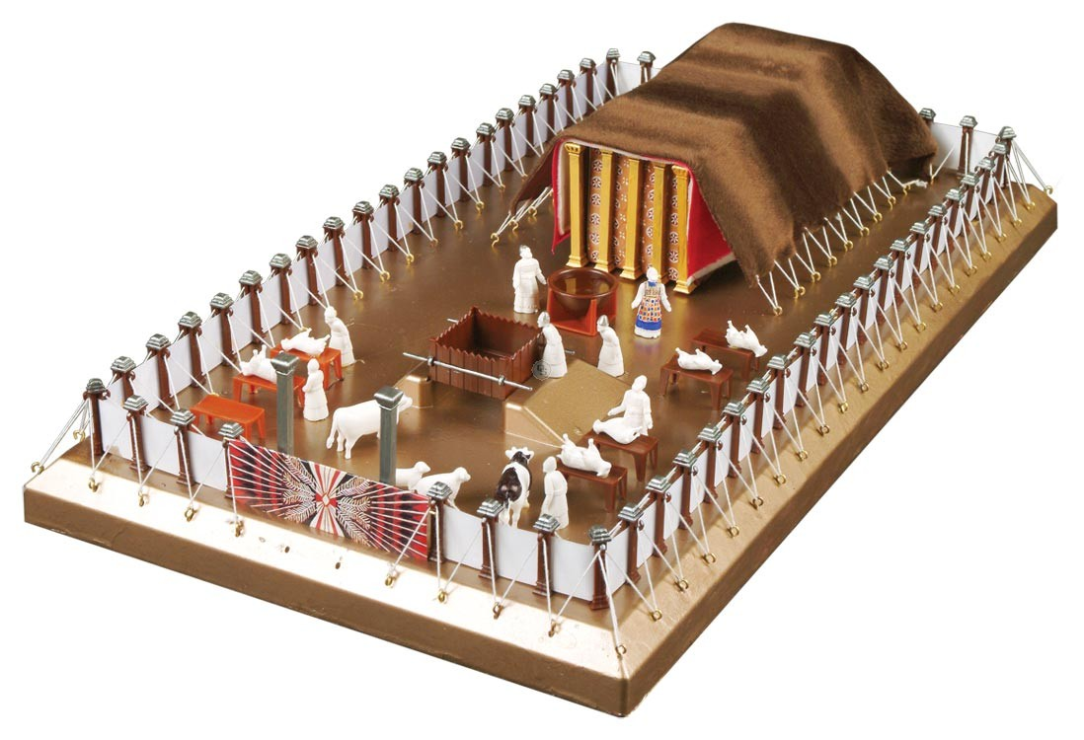

Slide 42
In Exodus 25
God showed Moses
a blueprint of the tabernacle
that the Israelites were to build.
He gave instructions as to
how to construct each part
What part was described first?

Slide 43
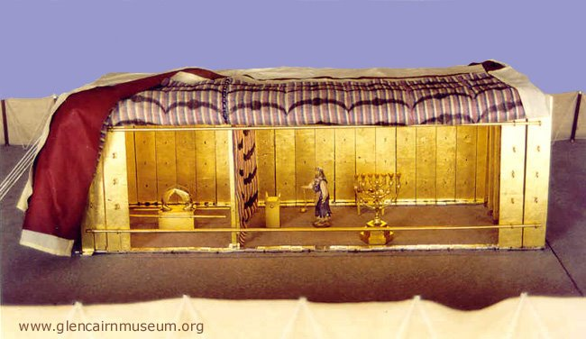
In Exodus 25
God showed Moses
a blueprint of the tabernacle
that the Israelites were to build.
He gave instructions as to
how to construct each part
God started with the Ark of the covenant

Slide 44
In Exodus 25
God showed Moses
a blueprint of the tabernacle
that the Israelites were to build.
In giving instructions as to
how to construct each part
Everything was described working its way out from God

Slide 45
In Exodus 25
God showed Moses
a blueprint of the tabernacle
that the Israelites were to build.
In giving instructions as to
how to construct each part
The Ark first
the gate last
Everything was described working its way out from God

Slide 46
In Exodus 25
God showed Moses
a blueprint of the tabernacle
that the Israelites were to build.
In giving instructions as to
how to construct each part
In practice the Ark was the final thing to reach as man approached

Slide 47
In Exodus 25
God showed Moses
a blueprint of the tabernacle
that the Israelites were to build.
In giving instructions as to
how to construct each part
The order has to be reversed because man enters the gate first then proceeds through everything else and
finally we come to the Ark
In practice the Ark was the final thing to reach as man approached

Slide 48
So we have to
reverse these 4 words
to follow how they work in practice
1 Peter 5:10
¹⁰ But the God of all grace,
who hath called us unto his eternal glory by Christ Jesus,
after that ye have suffered a while,
make you perfect, stablish, strengthen, settle you.
This is God’s long term plan for every believer
Perfect: that there remain no defect in you.
Stablish: that nothing shake you.
Strengthen: that you may be become stronger.
Settle: to give you a solid foundation.

Slide 49
So we might
reverse these words
to follow how they work in practice
1 Peter 5:10
¹⁰ But the God of all grace,
who hath called us unto his eternal glory by Christ Jesus,
after that ye have suffered a while,
make you perfect, stablish, strengthen, settle you.
Settled: Firstly we are given a firm foundation – a standing before God

Slide 50
So we might
reverse these words
to follow how they work in practice
1 Peter 5:10
¹⁰ But the God of all grace,
who hath called us unto his eternal glory by Christ Jesus,
after that ye have suffered a while,
make you perfect, stablish, strengthen, settle you.
Strengthen: Then we are made stronger each day as we grow
Settled: Firstly we are given a firm foundation – a standing before God

Slide 51
So we might
reverse these words
to follow how they work in practice
1 Peter 5:10
¹⁰ But the God of all grace,
who hath called us unto his eternal glory by Christ Jesus,
after that ye have suffered a while,
make you perfect, stablish, strengthen, settle you.
Can we visualize this work that God is doing in us?
Settled: Firstly we are given a firm foundation – a standing before God

Slide 52
So we might
reverse these words
to follow how they work in practice
1 Peter 5:10
¹⁰ But the God of all grace,
who hath called us unto his eternal glory by Christ Jesus,
after that ye have suffered a while,
make you perfect, stablish, strengthen, settle you.
Using Microsoft’s Ai – Copilot!
Settled: Firstly we are given a firm foundation – a standing before God

Slide 53
So we might
reverse these words
to follow how they work in practice
1 Peter 5:10
¹⁰ But the God of all grace,
who hath called us unto his eternal glory by Christ Jesus,
after that ye have suffered a while,
make you perfect, stablish, strengthen, settle you.
Ai – Give me a visual representation of settled
Settled: Firstly we are given a firm foundation – a standing before God

Slide 54
Settled: Firstly we are given a firm foundation – a standing before God

Slide 55
Give me a visual representation of settled in the sense
of firmly grounded
Settled: Firstly we are given a firm foundation – a standing before God

Slide 56
Settled: Firstly we are given a firm foundation – a standing before God

Slide 57
Make it more isolated, like out at sea
Settled: Firstly we are given a firm foundation – a standing before God

Slide 58
Settled: Firstly we are given a firm foundation – a standing before God

Slide 59
Remove the birds and
make it calmer
Settled: Firstly we are given a firm foundation – a standing before God

Slide 60
Settled: Firstly we are given a firm foundation – a standing before God

Slide 61
Ai
Give me a visual representation
of strengthened
Strengthen: Then we are made stronger each day as we grow

Slide 62
Strengthen: Then we are made stronger each day as we grow

Slide 63
Strengthened
in the sense of being built up
and made stronger
Strengthen: Then we are made stronger each day as we grow

Slide 64
Strengthen: Then we are made stronger each day as we grow

Slide 65
Strengthened
using the image at sea
Strengthen: Then we are made stronger each day as we grow

Slide 66
Strengthen: Then we are made stronger each day as we grow

Slide 67
Strengthen: Then we are made stronger each day as we grow
Settled: Firstly we are given a firm foundation – a standing before God

Slide 68
Ai
Give me a visual representation
of stablish
using an image at sea
Stablish: We become established and stable in our faith

Slide 69
Stablish: We become established and stable in our faith

Slide 70
add a storm
Stablish: We become established and stable in our faith

Slide 71
Stablish: We become established and stable in our faith

Slide 72
Stablish: We become established and stable in our faith
Strengthen: Then we are made stronger each day as we grow
Settled: Firstly we are given a firm foundation – a standing before God

Slide 73
Ai
Give me a visual representation
of perfection
Perfect: God will bring everything in us to completion and perfection

Slide 74
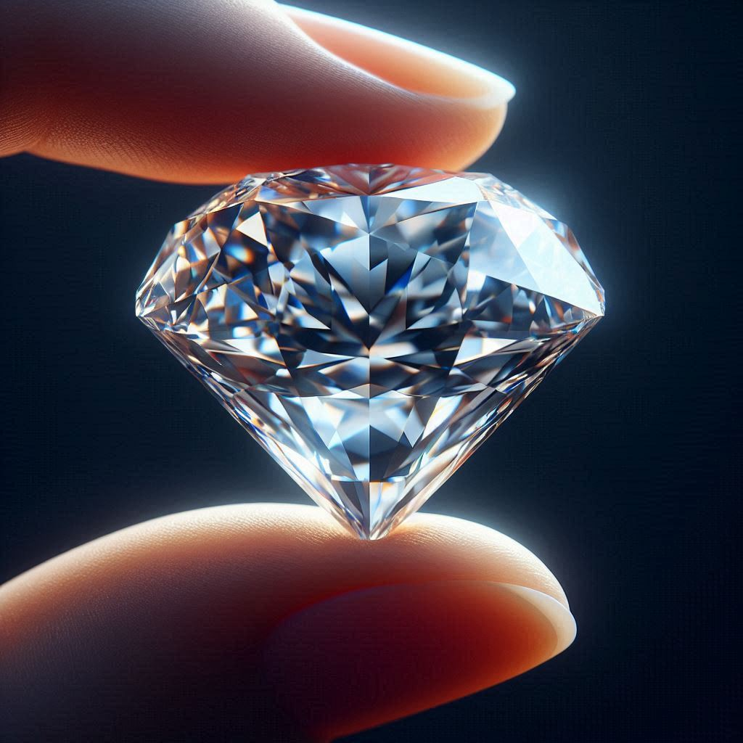
Perfect: God will bring everything in us to completion and perfection
Perfect: God will bring everything in us to completion and perfection

Slide 75
Perfect: God will bring everything in us to completion and perfection
The God of all grace:
Perfect: Will bring everything in us to completion and perfection
Stablish: Makes us become established and stable in our faith
Strengthen: Makes us stronger each day as we grow
Settled: Has given us a firm foundation – a standing before God

Slide 76
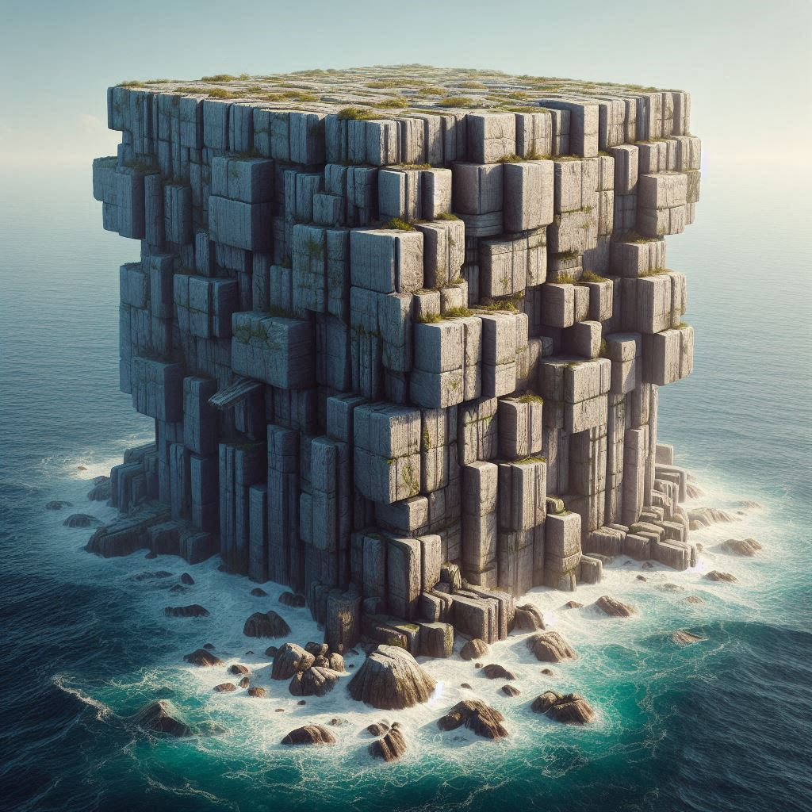
Settled
We are given a firm foundation – a standing before God

Slide 77
Strengthened
We are made stronger each day as we grow

Slide 78
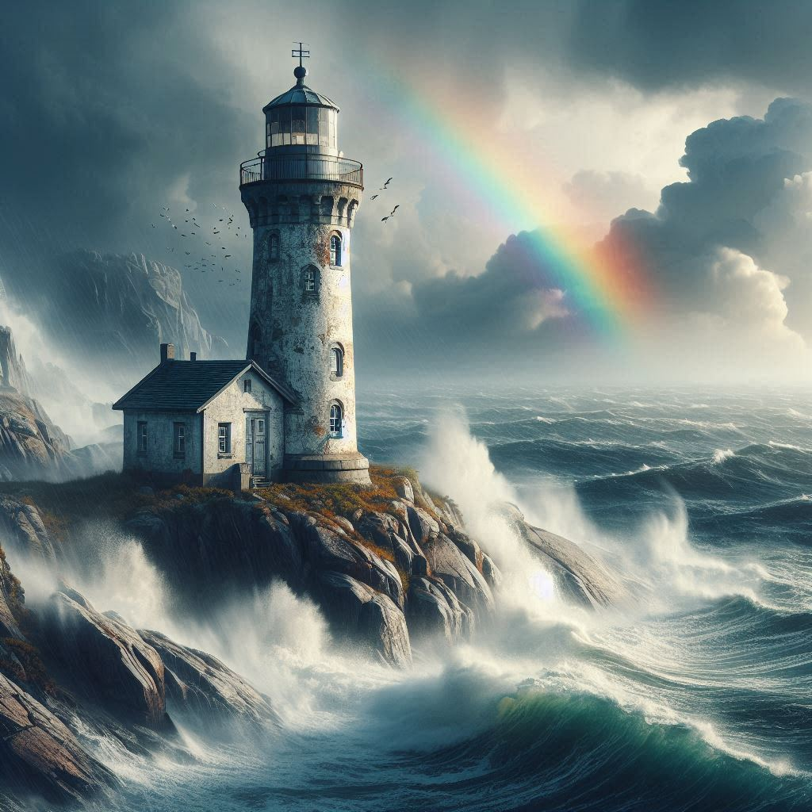
Stablished
We become stable so that nothing moves us

Slide 79
Perfect: God will bring everything in us to completion and perfection
Perfect
God will bring everything in us to completion and perfection

Slide 80
1 Peter 5:10
¹⁰ But the God of all grace,
who hath called us unto his eternal glory by Christ Jesus,
after that ye have suffered a while,
make you perfect, stablish, strengthen, settle you.
This is God’s long term plan for every believer
Perfect: that there remain no defect in you.
Stablish: that nothing shake you.
Strengthen: that you may be become stronger.
Settle: to give you a solid foundation.
What great encouragement to finish on!

Slide 81
1 Peter 5:10-14
¹² By Silvanus, a faithful brother unto you, as I suppose (in my estimation),
I have written briefly, exhorting, and testifying that this is the true grace of God wherein ye stand.
¹³ The church that is at Babylon, elected together with you, saluteth you;
and so doth Marcus my son.
¹⁴ Greet ye one another with a kiss of charity.
Peace be with you all that are in Christ Jesus.
Amen.

Slide 82
1 Peter 5:10-14
¹² By Silvanus, a faithful brother unto you, as I suppose (in my estimation),
I have written briefly, exhorting, and testifying that this is the true grace of God wherein ye stand.
¹³ The church that is at Babylon, elected together with you, saluteth you;
and so doth Marcus my son.
¹⁴ Greet ye one another with a kiss of charity.
Peace be with you all that are in Christ Jesus.
Amen.
An interesting expression!

Slide 83
1 Peter 5:10-14
Peter mentions ‘grace’ in every chapter: He finishes this letter with:
^{v12} …I have written briefly, exhorting, and testifying that
this is the true grace of God wherein ye stand.

Slide 84
1 Peter 5:10-14
Peter mentions ‘grace’ in every chapter: He finishes this letter with:
^{v12} …I have written briefly, exhorting, and testifying that
this is the true grace of God wherein ye stand.
The true grace of God:
Provides salvation for the sinner – 1v10

Slide 85
1 Peter 5:10-14
Peter mentions ‘grace’ in every chapter: He finishes this letter with:
^{v12} …I have written briefly, exhorting, and testifying that
this is the true grace of God wherein ye stand.
The true grace of God:
Provides salvation for the sinner – 1v10
Redeems the sinner with the precious blood of Christ – 1v19

Slide 86
1 Peter 5:10-14
Peter mentions ‘grace’ in every chapter: He finishes this letter with:
^{v12} …I have written briefly, exhorting, and testifying that
this is the true grace of God wherein ye stand.
The true grace of God:
Provides salvation for the sinner – 1v10
Redeems the sinner with the precious blood of Christ – 1v19
Enables him to grow by obeying the Word of God – 2v3

Slide 87
1 Peter 5:10-14
Peter mentions ‘grace’ in every chapter: He finishes this letter with:
^{v12} …I have written briefly, exhorting, and testifying that
this is the true grace of God wherein ye stand.
The true grace of God:
Provides salvation for the sinner – 1v10
Redeems the sinner with the precious blood of Christ – 1v19
Enables him to grow by obeying the Word of God – 2v3
Builds him up in God’s spiritual house and holy priesthood – 2v5

Slide 88
1 Peter 5:10-14
Peter mentions ‘grace’ in every chapter: He finishes this letter with:
^{v12} …I have written briefly, exhorting, and testifying that
this is the true grace of God wherein ye stand.
The true grace of God:
Provides salvation for the sinner – 1v10
Redeems the sinner with the precious blood of Christ – 1v19
Enables him to grow by obeying the Word of God – 2v3
Builds him up in God’s spiritual house and holy priesthood – 2v5
Strengthens him to withstand persecution and suffering for righteousness – 3v14

Slide 89
1 Peter 5:10-14
Peter mentions ‘grace’ in every chapter: He finishes this letter with:
^{v12} …I have written briefly, exhorting, and testifying that
this is the true grace of God wherein ye stand.
The true grace of God:
Provides salvation for the sinner – 1v10
Redeems the sinner with the precious blood of Christ – 1v19
Enables him to grow by obeying the Word of God – 2v3
Builds him up in God’s spiritual house and holy priesthood – 2v5
Strengthens him to withstand persecution and suffering for righteousness – 3v14
Gifts him with Spiritual help – 4v10

Slide 90
1 Peter 5:10-14
Peter mentions ‘grace’ in every chapter: He finishes this letter with:
^{v12} …I have written briefly, exhorting, and testifying that
this is the true grace of God wherein ye stand.
The true grace of God:
Provides salvation for the sinner – 1v10
Redeems the sinner with the precious blood of Christ – 1v19
Enables him to grow by obeying the Word of God – 2v3
Builds him up in God’s Spiritual house and holy priesthood – 2v5
Strengthens him to withstand persecution and suffering for righteousness – 3v14
Gifts him with Spiritual help – 4v10
Lifts his gaze and fills him with hope as he waits for the chief shepherd – 5v4

Slide 91
1 Peter 5:10-14
Peter mentions ‘grace’ in every chapter: He finishes this letter with:
^{v12} …I have written briefly, exhorting, and testifying that
this is the true grace of God wherein ye stand.
The true grace of God:
Provides salvation for the sinner – 1v10
Redeems the sinner with the precious blood of Christ – 1v19
Enables him to grow by obeying the Word of God – 2v3
Builds him up in God’s Spiritual house and holy priesthood – 2v5
Strengthens him to withstand persecution and suffering for righteousness – 3v14
Gifts him with Spiritual help – 4v10
Lifts his gaze and fills him with hope as he waits for the chief shepherd – 5v4
Keeps him humble so that he can resist the devil – 5v6

Slide 92
1 Peter 5:10-14
Peter mentions ‘grace’ in every chapter: He finishes this letter with:
^{v12} …I have written briefly, exhorting, and testifying that
this is the true grace of God wherein ye stand.
The true grace of God:
Provides salvation for the sinner – 1v10
Redeems the sinner with the precious blood of Christ – 1v19
Enables him to grow by obeying the Word of God – 2v3
Builds him up in God’s Spiritual house and holy priesthood – 2v5
Strengthens him to withstand persecution and suffering for righteousness – 3v14
Gifts him with Spiritual help – 4v10
Lifts his gaze and fills him with hope as he waits for the chief shepherd – 5v4
Keeps him humble so that he can resist the devil – 5v6
The God of all Grace will bring to perfection the work of God in his soul – 5v10

Slide 93
1 Peter 5:10-14
Peter mentions ‘grace’ in every chapter: He finishes this letter with:
^{v12} …I have written briefly, exhorting, and testifying that
this is the true grace of God wherein ye stand.
The true grace of God:
Provides salvation for the sinner – 1v10
Redeems the sinner with the precious blood of Christ – 1v19
Enables him to grow by obeying the Word of God – 2v3
Builds him up in God’s Spiritual house and holy priesthood – 2v5
Strengthens him to withstand persecution and suffering for righteousness – 3v14
Gifts him with Spiritual help – 4v10
Lifts his gaze and fills him with hope as he waits for the chief shepherd – 5v4
Keeps him humble so that he can resist the devil – 5v6
The God of all Grace will bring to perfection the work of God in his soul – 5v10
This is the true grace of God wherein we stand

Slide 94
1 Peter 5:10-14
¹⁰ But the God of all grace,
who hath called us unto his eternal glory by Christ Jesus,
after that ye have suffered a while,
make you perfect, stablish, strengthen, settle you.
¹¹ To him be glory and dominion for ever and ever. Amen.
¹² By Silvanus, a faithful brother unto you, as I suppose (in my estimation),
I have written briefly, exhorting, and testifying that this is the true grace of God wherein ye stand.
¹³ The church that is at Babylon, elected together with you, saluteth you;
and so doth Marcus my son.
¹⁴ Greet ye one another with a kiss of charity.
Peace be with you all that are in Christ Jesus.
Amen.
Silvanus (Silas)
and
Marcus (John Mark)
are mentioned together!
Silvanus (Silas)
And
Marcus (John Mark)
are mentioned together!

Slide 95
1 Peter 5:10-14
¹⁰ But the God of all grace,
who hath called us unto his eternal glory by Christ Jesus,
after that ye have suffered a while,
make you perfect, stablish, strengthen, settle you.
¹¹ To him be glory and dominion for ever and ever. Amen.
¹² By Silvanus, a faithful brother unto you, as I suppose (in my estimation),
I have written briefly, exhorting, and testifying that this is the true grace of God wherein ye stand.
¹³ The church that is at Babylon, elected together with you, saluteth you;
and so doth Marcus my son.
¹⁴ Greet ye one another with a kiss of charity.
Peace be with you all that are in Christ Jesus.
Amen.
Mark was most likely to be
John Mark, whose parents owned the upper room in Jerusalem.
It seems he came to faith through Peter’s preaching

Slide 96
1 Peter 5:10-14
¹⁰ But the God of all grace,
who hath called us unto his eternal glory by Christ Jesus,
after that ye have suffered a while,
make you perfect, stablish, strengthen, settle you.
¹¹ To him be glory and dominion for ever and ever. Amen.
¹² By Silvanus, a faithful brother unto you, as I suppose (in my estimation),
I have written briefly, exhorting, and testifying that this is the true grace of God wherein ye stand.
¹³ The church that is at Babylon, elected together with you, saluteth you;
and so doth Marcus my son.
¹⁴ Greet ye one another with a kiss of charity.
Peace be with you all that are in Christ Jesus.
Amen.
It was when Mark failed
that Silas was chosen
to take over and accompany Paul on his missionary journeys
Silvanus (Silas)
And
Marcus (John Mark)
are mentioned together!

Slide 97
1 Peter 5:10-14
¹⁰ But the God of all grace,
who hath called us unto his eternal glory by Christ Jesus,
after that ye have suffered a while,
make you perfect, stablish, strengthen, settle you.
¹¹ To him be glory and dominion for ever and ever. Amen.
¹² By Silvanus, a faithful brother unto you, as I suppose (in my estimation),
I have written briefly, exhorting, and testifying that this is the true grace of God wherein ye stand.
¹³ The church that is at Babylon, elected together with you, saluteth you;
and so doth Marcus my son.
¹⁴ Greet ye one another with a kiss of charity.
Peace be with you all that are in Christ Jesus.
Amen.
But now they are working together without any grudges between them
Silvanus (Silas)
And
Marcus (John Mark)
are mentioned together!

Slide 98
1 Peter 5:10-14
¹⁰ But the God of all grace,
who hath called us unto his eternal glory by Christ Jesus,
after that ye have suffered a while,
make you perfect, stablish, strengthen, settle you.
¹¹ To him be glory and dominion for ever and ever. Amen.
¹² By Silvanus, a faithful brother unto you, as I suppose (in my estimation),
I have written briefly, exhorting, and testifying that this is the true grace of God wherein ye stand.
¹³ The church that is at Babylon, elected together with you, saluteth you;
and so doth Marcus my son.
¹⁴ Greet ye one another with a kiss of charity.
Peace be with you all that are in Christ Jesus.
Amen.
Peter also speaking
of Silas, the Gentile and
calls him a faithful brother
Silvanus (Silas)
And
Marcus (John Mark)
are mentioned together!

Slide 99
1 Peter 5:10-14
¹⁰ But the God of all grace,
who hath called us unto his eternal glory by Christ Jesus,
after that ye have suffered a while,
make you perfect, stablish, strengthen, settle you.
¹¹ To him be glory and dominion for ever and ever. Amen.
¹² By Silvanus, a faithful brother unto you, as I suppose (in my estimation),
I have written briefly, exhorting, and testifying that this is the true grace of God wherein ye stand.
¹³ The church that is at Babylon, elected together with you, saluteth you;
and so doth Marcus my son.
¹⁴ Greet ye one another with a kiss of charity.
Peace be with you all that are in Christ Jesus.
Amen.
There was great
fellowship and love enjoyed by these the Lord’s servants
Silvanus (Silas)
And
Marcus (John Mark)
are mentioned together!

