Slide 1
Bible Study
1st Peter

Slide 2
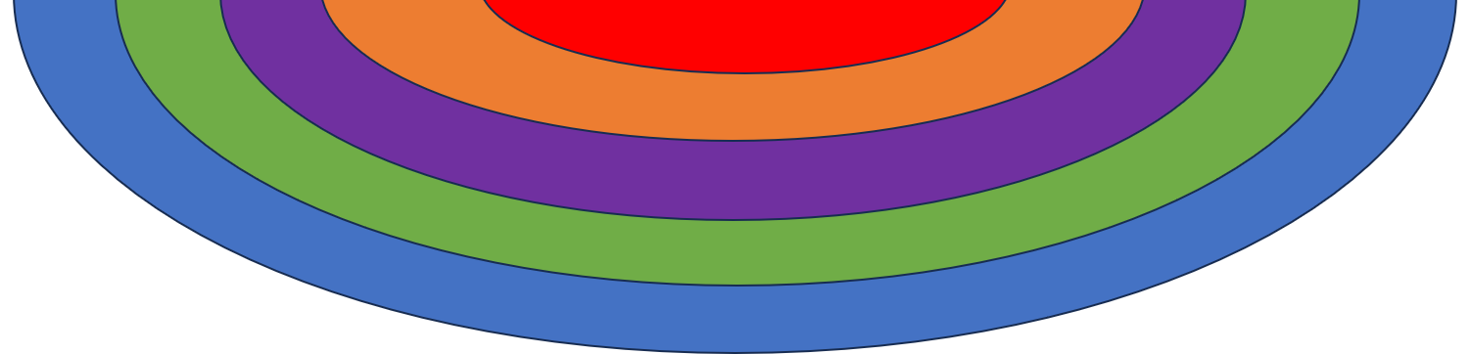
Good (9x) and Evil (10x)
Faith, Hope and Love
Time (10x) and Opportunity (10x)
1st Peter
Order in New Testament
Number of Chapters
Historical Setting
Suffering (16x) and Glory (16x)
21
Written about AD65
possibly from Rome
5
The Gospels and the Acts
Written by:
Written to:
Written for:
Key Theme or Verse
OVERVIEW:
The Apostle Peter
An Apostle and
foundational leader
Believers scattered
due to persecution,
going through suffering
To encourage the believers to honour
God even in trials
if any man suffer as a Christian, let him not be ashamed; but let him glorify God on this behalf. 1 Peter 4:16
Major Themes running through the Letter
The Sufferings of our Lord Jesus Christ
To provide Salvation
v11
v21
v18
v1
v1
1
To leave us
an Example
To fulfil God’s Will
4
To deliver us
from our sins
To care for the Flock
2
3
5
The Christian life:
being Born Again
The Christian life:
as new born babes
The Christian life:
in the Family
The Christian life:
in the Lord’s service
The Christian life:
in later years
Begotten us to a living hope:
To an incorruptible inheritance,
which is undefiled,
and that fadeth not away,
reserved in heaven for us.
Growing in grace:
By desiring the sincere milk of the Word and following the steps of Christ through the example he left.
Love as brethren:
Be pitiful, be courteous:
Not rendering evil for evil, or railing for railing:
but contrariwise blessing.
Living a sanctified, godly life:
This will bring the believer into a place of suffering just like Christ.
But it is better to be a martyr than a murderer.
Practical encouragements
for growing older:
Stay humble.
Cast all your care upon Him.
Stay alert, the devil is wicked.
Practical:
Ever keeping the sufferings of Christ and his glory before us will enable us to endure whatever trials and persecutions come into our lives, for his name’s sake.

Slide 3
1 Peter 5:1-4
The elders which are among you I exhort, who am also an elder,
and a witness of the sufferings of Christ,
and also a partaker of the glory that shall be revealed:
Feed the flock of God which is among you, taking the oversight thereof, not by constraint, but willingly; not for filthy lucre, but of a ready mind; Neither as being lords over God's heritage, but being ensamples to the flock.
And when the chief Shepherd shall appear, ye shall receive a crown of glory that fadeth not away.

Slide 4
1 Peter 5:1-4 (KJV)
The elders which are among you I exhort, who am also an elder,
and a witness of the sufferings of Christ,
and also a partaker of the glory that shall be revealed:
Feed the flock of God which is among you, taking the oversight thereof, not by constraint, but willingly; not for filthy lucre, but of a ready mind; Neither as being lords over God's heritage, but being ensamples to the flock.
And when the chief Shepherd shall appear, ye shall receive a crown of glory that fadeth not away.
1 Peter 5:1-4 (ESV)
So I exhort the elders among you, as a fellow elder
and a witness of the sufferings of Christ,
as well as a partaker in the glory that is going to be revealed:
Shepherd the flock of God that is among you, exercising oversight, not under compulsion,
but willingly, as God would have you; not for shameful gain, but eagerly; not domineering over those in your charge, but being examples to the flock.
And when the chief Shepherd appears, you will receive the unfading crown of glory.

Slide 5
1 Peter 5:1-4 (KJV)
The elders which are among you I exhort, who am also an elder,
and a witness of the sufferings of Christ,
and also a partaker of the glory that shall be revealed:
Feed the flock of God which is among you, taking the oversight thereof, not by constraint, but willingly; not for filthy lucre, but of a ready mind; Neither as being lords over God's heritage, but being ensamples to the flock.
And when the chief Shepherd shall appear, ye shall receive a crown of glory that fadeth not away.
1 Peter 5:1-4 (ESV)
So I exhort the elders among you, as a fellow elder
and a witness of the sufferings of Christ,
as well as a partaker in the glory that is going to be revealed:
Shepherd the flock of God that is among you, exercising oversight, not under compulsion,
but willingly, as God would have you; not for shameful gain, but eagerly; not domineering over those in your charge, but being examples to the flock.
And when the chief Shepherd appears, you will receive the unfading crown of glory.

Slide 6
1 Peter 5:1-4 (KJV)
The elders which are among you I exhort, who am also an elder,
and a witness of the sufferings of Christ,
and also a partaker of the glory that shall be revealed:
Feed the flock of God which is among you, taking the oversight thereof, not by constraint, but willingly; not for filthy lucre, but of a ready mind; Neither as being lords over God's heritage, but being ensamples to the flock.
And when the chief Shepherd shall appear, ye shall receive a crown of glory that fadeth not away.
1 Peter 5:1-4 (ESV)
So I exhort the elders among you, as a fellow elder
and a witness of the sufferings of Christ,
as well as a partaker in the glory that is going to be revealed:
Shepherd the flock of God that is among you, exercising oversight, not under compulsion,
but willingly, as God would have you; not for shameful gain, but eagerly; not domineering over those in your charge, but being examples to the flock.
And when the chief Shepherd appears, you will receive the unfading crown of glory.

Slide 7
1 Peter 5:1-4 (KJV)
The elders which are among you I exhort, who am also an elder,
and a witness of the sufferings of Christ,
and also a partaker of the glory that shall be revealed:
Feed the flock of God which is among you, taking the oversight thereof, not by constraint, but willingly; not for filthy lucre, but of a ready mind; Neither as being lords over God's heritage, but being ensamples to the flock.
And when the chief Shepherd shall appear, ye shall receive a crown of glory that fadeth not away.
1 Peter 5:1-4 (ESV)
So I exhort the elders among you, as a fellow elder
and a witness of the sufferings of Christ,
as well as a partaker in the glory that is going to be revealed:
Shepherd the flock of God that is among you, exercising oversight, not under compulsion,
but willingly, as God would have you; not for shameful gain, but eagerly; not domineering over those in your charge, but being examples to the flock.
And when the chief Shepherd appears, you will receive the unfading crown of glory.

Slide 8
1 Peter 5:1-4 (KJV)
The elders which are among you I exhort, who am also an elder,
and a witness of the sufferings of Christ,
and also a partaker of the glory that shall be revealed:
Feed the flock of God which is among you, taking the oversight thereof, not by constraint, but willingly; not for filthy lucre, but of a ready mind; Neither as being lords over God's heritage, but being ensamples to the flock.
And when the chief Shepherd shall appear, ye shall receive a crown of glory that fadeth not away.
1 Peter 5:1-4 (ESV)
So I exhort the elders among you, as a fellow elder
and a witness of the sufferings of Christ,
as well as a partaker in the glory that is going to be revealed:
Shepherd the flock of God that is among you, exercising oversight, not under compulsion,
but willingly, as God would have you; not for shameful gain, but eagerly; not domineering over those in your charge, but being examples to the flock.
And when the chief Shepherd appears, you will receive the unfading crown of glory.

Slide 9
1 Peter 5:1-4 (KJV)
The elders which are among you I exhort, who am also an elder,
and a witness of the sufferings of Christ,
and also a partaker of the glory that shall be revealed:
Feed the flock of God which is among you, taking the oversight thereof, not by constraint, but willingly; not for filthy lucre, but of a ready mind; Neither as being lords over God's heritage, but being ensamples to the flock.
And when the chief Shepherd shall appear, ye shall receive a crown of glory that fadeth not away.
1 Peter 5:1-4 (ESV)
So I exhort the elders among you, as a fellow elder
and a witness of the sufferings of Christ,
as well as a partaker in the glory that is going to be revealed:
Shepherd the flock of God that is among you, exercising oversight, not under compulsion,
but willingly, as God would have you; not for shameful gain, but eagerly; not domineering over those in your charge, but being examples to the flock.
And when the chief Shepherd appears, you will receive the unfading crown of glory.

Slide 10
1 Peter 5:1-4 (KJV)
The elders which are among you I exhort, who am also an elder,
and a witness of the sufferings of Christ,
and also a partaker of the glory that shall be revealed:
Feed the flock of God which is among you, taking the oversight thereof, not by constraint, but willingly; not for filthy lucre, but of a ready mind; Neither as being lords over God's heritage, but being ensamples to the flock.
And when the chief Shepherd shall appear, ye shall receive a crown of glory that fadeth not away.
1 Peter 5:1-4 (ESV)
So I exhort the elders among you, as a fellow elder
and a witness of the sufferings of Christ,
as well as a partaker in the glory that is going to be revealed:
Shepherd the flock of God that is among you, exercising oversight, not under compulsion,
but willingly, as God would have you; not for shameful gain, but eagerly; not domineering over those in your charge, but being examples to the flock.
And when the chief Shepherd appears, you will receive the unfading crown of glory.

Slide 11
1 Peter 5:1-4 (KJV)
The elders which are among you I exhort, who am also an elder,
and a witness of the sufferings of Christ,
and also a partaker of the glory that shall be revealed:
Feed the flock of God which is among you, taking the oversight thereof, not by constraint, but willingly; not for filthy lucre, but of a ready mind; Neither as being lords over God's heritage, but being ensamples to the flock.
And when the chief Shepherd shall appear, ye shall receive a crown of glory that fadeth not away.
1 Peter 5:1-4 (ESV)
So I exhort the elders among you, as a fellow elder
and a witness of the sufferings of Christ,
as well as a partaker in the glory that is going to be revealed:
Shepherd the flock of God that is among you, exercising oversight, not under compulsion,
but willingly, as God would have you; not for shameful gain, but eagerly; not domineering over those in your charge, but being examples to the flock.
And when the chief Shepherd appears, you will receive the unfading crown of glory.

Slide 12
1 Peter 5:1-4 (KJV)
The elders which are among you I exhort, who am also an elder,
and a witness of the sufferings of Christ,
and also a partaker of the glory that shall be revealed:
Feed the flock of God which is among you, taking the oversight thereof, not by constraint, but willingly; not for filthy lucre, but of a ready mind; Neither as being lords over God's heritage, but being ensamples to the flock.
And when the chief Shepherd shall appear, ye shall receive a crown of glory that fadeth not away.
1 Peter 5:1-4 (ESV)
So I exhort the elders among you, as a fellow elder
and a witness of the sufferings of Christ,
as well as a partaker in the glory that is going to be revealed:
Shepherd the flock of God that is among you, exercising oversight, not under compulsion,
but willingly, as God would have you; not for shameful gain, but eagerly; not domineering over those in your charge, but being examples to the flock.
And when the chief Shepherd appears, you will receive the unfading crown of glory.

Slide 13
1 Peter 5:1-4 (KJV)
The elders which are among you I exhort, who am also an elder,
and a witness of the sufferings of Christ,
and also a partaker of the glory that shall be revealed:
Feed the flock of God which is among you, taking the oversight thereof, not by constraint, but willingly; not for filthy lucre, but of a ready mind; Neither as being lords over God's heritage, but being ensamples to the flock.
And when the chief Shepherd shall appear, ye shall receive a crown of glory that fadeth not away.
1 Peter 5:1-4 (ESV)
So I exhort the elders among you, as a fellow elder
and a witness of the sufferings of Christ,
as well as a partaker in the glory that is going to be revealed:
Shepherd the flock of God that is among you, exercising oversight, not under compulsion,
but willingly, as God would have you; not for shameful gain, but eagerly; not domineering over those in your charge, but being examples to the flock.
And when the chief Shepherd appears, you will receive the unfading crown of glory.

Slide 14
1 Peter 5:1-4 (KJV)
The elders which are among you I exhort, who am also an elder,
and a witness of the sufferings of Christ,
and also a partaker of the glory that shall be revealed:
Feed the flock of God which is among you, taking the oversight thereof, not by constraint, but willingly; not for filthy lucre, but of a ready mind; Neither as being lords over God's heritage, but being ensamples to the flock.
And when the chief Shepherd shall appear, ye shall receive a crown of glory that fadeth not away.
1 Peter 5:1-4 (ESV)
So I exhort the elders among you, as a fellow elder
and a witness of the sufferings of Christ,
as well as a partaker in the glory that is going to be revealed:
Shepherd the flock of God that is among you, exercising oversight, not under compulsion,
but willingly, as God would have you; not for shameful gain, but eagerly; not domineering over those in your charge, but being examples to the flock.
And when the chief Shepherd appears, you will receive the unfading crown of glory.

Slide 15
1 Peter 5:1-4 (KJV)
The elders which are among you I exhort, who am also an elder,
and a witness of the sufferings of Christ,
and also a partaker of the glory that shall be revealed:
Feed the flock of God which is among you, taking the oversight thereof, not by constraint, but willingly; not for filthy lucre, but of a ready mind; Neither as being lords over God's heritage, but being ensamples to the flock.
And when the chief Shepherd shall appear, ye shall receive a crown of glory that fadeth not away.
1 Peter 5:1-4 (ESV)
So I exhort the elders among you, as a fellow elder
and a witness of the sufferings of Christ,
as well as a partaker in the glory that is going to be revealed:
Shepherd the flock of God that is among you, exercising oversight, not under compulsion,
but willingly, as God would have you; not for shameful gain, but eagerly; not domineering over those in your charge, but being examples to the flock.
And when the chief Shepherd appears, you will receive the unfading crown of glory.

Slide 16
1 Peter 5:1-4 (KJV)
The elders which are among you I exhort, who am also an elder,
and a witness of the sufferings of Christ,
and also a partaker of the glory that shall be revealed:
Feed the flock of God which is among you, taking the oversight thereof, not by constraint, but willingly; not for filthy lucre, but of a ready mind; Neither as being lords over God's heritage, but being ensamples to the flock.
And when the chief Shepherd shall appear, ye shall receive a crown of glory that fadeth not away.
1 Peter 5:1-4 (ESV)
So I exhort the elders among you, as a fellow elder
and a witness of the sufferings of Christ,
as well as a partaker in the glory that is going to be revealed:
Shepherd the flock of God that is among you, exercising oversight, not under compulsion,
but willingly, as God would have you; not for shameful gain, but eagerly; not domineering over those in your charge, but being examples to the flock.
And when the chief Shepherd appears, you will receive the unfading crown of glory.
g4165. ποιμαίνω poimainō;
to tend as a shepherd or (figuratively, superviser):
feed (cattle), to rule, to tend a flock, keep sheep
AV (11) - feed 6, rule 4, feed cattle 1;

Slide 17
1 Peter 5:1-4 (KJV)
The elders which are among you I exhort, who am also an elder,
and a witness of the sufferings of Christ,
and also a partaker of the glory that shall be revealed:
Feed the flock of God which is among you, taking the oversight thereof, not by constraint, but willingly; not for filthy lucre, but of a ready mind; Neither as being lords over God's heritage, but being ensamples to the flock.
And when the chief Shepherd shall appear, ye shall receive a crown of glory that fadeth not away.
1 Peter 5:1-4 (ESV)
So I exhort the elders among you, as a fellow elder
and a witness of the sufferings of Christ,
as well as a partaker in the glory that is going to be revealed:
Shepherd the flock of God that is among you, exercising oversight, not under compulsion,
but willingly, as God would have you; not for shameful gain, but eagerly; not domineering over those in your charge, but being examples to the flock.
And when the chief Shepherd appears, you will receive the unfading crown of glory.
g0317. ἀναγκαστῶς anagkastōs;
compulsorily: by constraint, by force
AV (1) - by constraint 1;

Slide 18
1 Peter 5:1-4 (KJV)
The elders which are among you I exhort, who am also an elder,
and a witness of the sufferings of Christ,
and also a partaker of the glory that shall be revealed:
Feed the flock of God which is among you, taking the oversight thereof, not by constraint, but willingly; not for filthy lucre, but of a ready mind; Neither as being lords over God's heritage, but being ensamples to the flock.
And when the chief Shepherd shall appear, ye shall receive a crown of glory that fadeth not away.
1 Peter 5:1-4 (ESV)
So I exhort the elders among you, as a fellow elder
and a witness of the sufferings of Christ,
as well as a partaker in the glory that is going to be revealed:
Shepherd the flock of God that is among you, exercising oversight, not under compulsion,
but willingly, as God would have you; not for shameful gain, but eagerly; not domineering over those in your charge, but being examples to the flock.
And when the chief Shepherd appears, you will receive the unfading crown of glory.
g0146. αἰσχροκερδής aischrokerdēs; sordidly: — for filthy lucre's sake; eagerness for base gain.
AV (4) - for filthy lucre 1; ;greedy of filthy lucre 2, given to filthy lucre 1;
The main focus is being eager to get something
for yourself, by any means.

Slide 19
1 Peter 5:1-4 (KJV)
The elders which are among you I exhort, who am also an elder,
and a witness of the sufferings of Christ,
and also a partaker of the glory that shall be revealed:
Feed the flock of God which is among you, taking the oversight thereof, not by constraint, but willingly; not for filthy lucre, but of a ready mind; Neither as being lords over God's heritage, but being ensamples to the flock.
And when the chief Shepherd shall appear, ye shall receive a crown of glory that fadeth not away.
1 Peter 5:1-4 (ESV)
So I exhort the elders among you, as a fellow elder
and a witness of the sufferings of Christ,
as well as a partaker in the glory that is going to be revealed:
Shepherd the flock of God that is among you, exercising oversight, not under compulsion,
but willingly, as God would have you; not for shameful gain, but eagerly; not domineering over those in your charge, but being examples to the flock.
And when the chief Shepherd appears, you will receive the unfading crown of glory.
g2634. κατακυριεύω katakyrieuō;
To bring under one's power, to subject to one's self, to subdue, to hold in subjection, to be master of, exercise lordship over
AV (4) - exercise dominion over 1, overcome 1,
be lord over 1, exercise lordship over 1;

Slide 20
1 Peter 5:1-4 (KJV)
The elders which are among you I exhort, who am also an elder,
and a witness of the sufferings of Christ,
and also a partaker of the glory that shall be revealed:
Feed the flock of God which is among you, taking the oversight thereof, not by constraint, but willingly; not for filthy lucre, but of a ready mind; Neither as being lords over God's heritage, but being ensamples to the flock.
And when the chief Shepherd shall appear, ye shall receive a crown of glory that fadeth not away.
1 Peter 5:1-4 (ESV)
So I exhort the elders among you, as a fellow elder
and a witness of the sufferings of Christ,
as well as a partaker in the glory that is going to be revealed:
Shepherd the flock of God that is among you, exercising oversight, not under compulsion,
but willingly, as God would have you; not for shameful gain, but eagerly; not domineering over those in your charge, but being examples to the flock.
And when the chief Shepherd appears, you will receive the unfading crown of glory.
g2819. κλῆρος klēros;
a portion; an acquisition; a heritage
inheritance, lot, part.
AV (13) - lot 8, part 2, inheritance 2, heritage 1;

Slide 21
1 Peter 5:1-4
The elders which are among you I exhort, who am also an elder,
and a witness of the sufferings of Christ,
and also a partaker of the glory that shall be revealed:
Feed the flock of God which is among you, taking the oversight thereof, not by constraint, but willingly; not for filthy lucre, but of a ready mind; Neither as being lords over God's heritage, but being ensamples to the flock.
And when the chief Shepherd shall appear, ye shall receive a crown of glory that fadeth not away.

Slide 22
1 Peter 5:1-4
The elders which are among you I exhort, who am also an elder,
and a witness of the sufferings of Christ,
and also a partaker of the glory that shall be revealed:
Feed the flock of God which is among you, taking the oversight thereof, not by constraint, but willingly; not for filthy lucre, but of a ready mind; Neither as being lords over God's heritage, but being ensamples to the flock.
And when the chief Shepherd shall appear, ye shall receive a crown of glory that fadeth not away.
It can be very helpful in reading text
to separate the actual statements made
from additional information about the statements

Slide 23
1 Peter 5:1-4
The elders which are among you I exhort, who am also an elder,
and a witness of the sufferings of Christ,
and also a partaker of the glory that shall be revealed:
Feed the flock of God which is among you, taking the oversight thereof, not by constraint, but willingly; not for filthy lucre, but of a ready mind; Neither as being lords over God's heritage, but being ensamples to the flock.
And when the chief Shepherd shall appear, ye shall receive a crown of glory that fadeth not away.
This is a statement

Slide 24
1 Peter 5:1-4
The elders which are among you I exhort, who am also an elder,
and a witness of the sufferings of Christ,
and also a partaker of the glory that shall be revealed:
Feed the flock of God which is among you, taking the oversight thereof, not by constraint, but willingly; not for filthy lucre, but of a ready mind; Neither as being lords over God's heritage, but being ensamples to the flock.
And when the chief Shepherd shall appear, ye shall receive a crown of glory that fadeth not away.
This is a statement
This is additional information

Slide 25
1 Peter 5:1-4
The elders which are among you I exhort, ( who am also an elder,
and a witness of the sufferings of Christ,
and also a partaker of the glory that shall be revealed: )
Feed the flock of God which is among you, taking the oversight thereof, not by constraint, but willingly; not for filthy lucre, but of a ready mind; Neither as being lords over God's heritage, but being ensamples to the flock.
And when the chief Shepherd shall appear, ye shall receive a crown of glory that fadeth not away.
We can use parenthesis (…)
to separate out the additional information

Slide 26
1 Peter 5:1-4
The elders which are among you I exhort, ( who am also an elder,
and a witness of the sufferings of Christ,
and also a partaker of the glory that shall be revealed: )
Feed the flock of God which is among you, (taking the oversight thereof, not by constraint, but willingly; not for filthy lucre, but of a ready mind; Neither as being lords over God's heritage, but being ensamples to the flock.)
And when the chief Shepherd shall appear, ye shall receive a crown of glory that fadeth not away.

Slide 27
1 Peter 5:1-4
The elders which are among you I exhort,
( who am also an elder, and a witness of the sufferings of Christ,
and also a partaker of the glory that shall be revealed: )
Feed the flock of God which is among you,
( taking the oversight thereof, not by constraint, but willingly;
not for filthy lucre, but of a ready mind; Neither as being lords over God's heritage,
but being ensamples to the flock. )
And when the chief Shepherd shall appear,
ye shall receive a crown of glory that fadeth not away.
We have 3 statements
We have 3 statements
We have 3 statements

Slide 28
1 Peter 5:1-4
The elders which are among you I exhort,
( who am also an elder, and a witness of the sufferings of Christ,
and also a partaker of the glory that shall be revealed: )
Feed the flock of God which is among you,
( taking the oversight thereof, not by constraint, but willingly;
not for filthy lucre, but of a ready mind; Neither as being lords over God's heritage,
but being ensamples to the flock. )
And when the chief Shepherd shall appear,
ye shall receive a crown of glory that fadeth not away.
Followed by 2 additional pieces of information
Followed by 2 additional pieces of information

Slide 29
1 Peter 5:1-4
The elders which are among you I exhort,
( who am also an elder, and a witness of the sufferings of Christ,
and also a partaker of the glory that shall be revealed: )
Feed the flock of God which is among you,
( taking the oversight thereof, not by constraint, but willingly;
not for filthy lucre, but of a ready mind; Neither as being lords over God's heritage,
but being ensamples to the flock. )
And when the chief Shepherd shall appear,
ye shall receive a crown of glory that fadeth not away.
There are only 3 actual statements!
There are only 3 actual statements!
There are only 3 actual statements!

Slide 30
1 Peter 5:1-4
The elders which are among you I exhort,
( who am also an elder, and a witness of the sufferings of Christ,
and also a partaker of the glory that shall be revealed: )
Feed the flock of God which is among you,
( taking the oversight thereof, not by constraint, but willingly;
not for filthy lucre, but of a ready mind; Neither as being lords over God's heritage,
but being ensamples to the flock. )
And when the chief Shepherd shall appear,
ye shall receive a crown of glory that fadeth not away.
Note how these statements are in keeping with how Peter
has been teaching throughout the letter:
He encourages them to keep serving in the present
Because the Lord has something far greater in store for them in the future

Slide 31
1 Peter 5:1-4
The elders which are among you I exhort,
( who am also an elder, and a witness of the sufferings of Christ,
and also a partaker of the glory that shall be revealed: )
Feed the flock of God which is among you,
( taking the oversight thereof, not by constraint, but willingly;
not for filthy lucre, but of a ready mind; Neither as being lords over God's heritage,
but being ensamples to the flock. )
And when the chief Shepherd shall appear,
ye shall receive a crown of glory that fadeth not away.
Note how these statements are in keeping with how Peter
has been teaching throughout the letter:
He encourages them to keep serving in the present
Because the Lord has something far greater in store for them in the future

Slide 32
1 Peter 5:1-4
The elders which are among you I exhort,
( who am also an elder, and a witness of the sufferings of Christ,
and also a partaker of the glory that shall be revealed: )
Feed the flock of God which is among you,
( taking the oversight thereof, not by constraint, but willingly;
not for filthy lucre, but of a ready mind; Neither as being lords over God's heritage,
but being ensamples to the flock. )
And when the chief Shepherd shall appear,
ye shall receive a crown of glory that fadeth not away.
Note how these statements are in keeping with how Peter
has been teaching throughout the letter:
He encourages them to keep serving in the present
Because the Lord has something far greater in store for them in the future

Slide 33
1 Peter 5:1-4
The elders which are among you I exhort,
( who am also an elder, and a witness of the sufferings of Christ,
and also a partaker of the glory that shall be revealed: )
Feed the flock of God which is among you,
( taking the oversight thereof, not by constraint, but willingly;
not for filthy lucre, but of a ready mind; Neither as being lords over God's heritage,
but being ensamples to the flock. )
And when the chief Shepherd shall appear,
ye shall receive a crown of glory that fadeth not away.
This is a recurring theme:
Living in the present…
in light of the future
Note how these statements are in keeping with how Peter
has been teaching throughout the letter:
He encourages them to keep serving in the present
Because the Lord has something far greater in store for them in the future

Slide 34
1 Peter 5:1-4
The elders which are among you I exhort,
( who am also an elder, and a witness of the sufferings of Christ,
and also a partaker of the glory that shall be revealed: )
Feed the flock of God which is among you,
( taking the oversight thereof, not by constraint, but willingly;
not for filthy lucre, but of a ready mind; Neither as being lords over God's heritage,
but being ensamples to the flock. )
And when the chief Shepherd shall appear,
ye shall receive a crown of glory that fadeth not away.
We can now look at the additional information
contained in the parenthesis
We can look at the text as statements,
separated with additional information
contained in the parenthesis

Slide 35
1 Peter 5:1-4
​The elders which are among you I exhort,
    who am also an elder,
    and a witness of the sufferings of Christ,
    and also a partaker of the glory that shall be revealed:
Feed the flock of God which is among you,
    taking the oversight thereof, not by constraint, but willingly;
    not for filthy lucre, but of a ready mind;
    Neither as being lords over God's heritage, but being ensamples to the flock.
And when the chief Shepherd shall appear,
ye shall receive a crown of glory that fadeth not away.
In relation to the first statement:
Peter gives 3 additional pieces of information

Slide 36
1 Peter 5:1-4
​The elders which are among you I exhort,
    who am also an elder,
    and a witness of the sufferings of Christ,
    and also a partaker of the glory that shall be revealed:
Feed the flock of God which is among you,
    taking the oversight thereof, not by constraint, but willingly;
    not for filthy lucre, but of a ready mind;
    Neither as being lords over God's heritage, but being ensamples to the flock.
And when the chief Shepherd shall appear,
ye shall receive a crown of glory that fadeth not away.
In relation to the second statement:
He gives 3 “not – but” pairs

Slide 37
1 Peter 5:1-4
​The elders which are among you I exhort,
    who am also an elder,
    and a witness of the sufferings of Christ,
    and also a partaker of the glory that shall be revealed:
Feed the flock of God which is among you,
    taking the oversight thereof, not by constraint, but willingly;
    not for filthy lucre, but of a ready mind;
    Neither as being lords over God's heritage, but being ensamples to the flock.
And when the chief Shepherd shall appear,
ye shall receive a crown of glory that fadeth not away.
The structure is almost poetic!
There are 3 statements
separated by information grouped in 3’s

Slide 38
1 Peter 5:1-4
​The elders which are among you I exhort,
    who am also an elder,
    and a witness of the sufferings of Christ,
    and also a partaker of the glory that shall be revealed:
Feed the flock of God which is among you,
    taking the oversight thereof, not by constraint, but willingly;
    not for filthy lucre, but of a ready mind;
    Neither as being lords over God's heritage, but being ensamples to the flock.
And when the chief Shepherd shall appear,
ye shall receive a crown of glory that fadeth not away.

Slide 39
1 Peter 5:1-4
​The elders which are among you I exhort,
    who am also an elder
Peter is not commanding them as an Apostle

Slide 40
1 Peter 5:1-4
​The elders which are among you I exhort,
    who am also an elder
He appeals to them as one who knows
what it means to be an elder
(not just an older person but a shepherd in God’s Assembly)

Slide 41
1 Peter 5:1-4
​The elders which are among you I exhort,
    who am also an elder
We need to consider the role of elders
and the structure of a New Testament Assembly

Slide 42
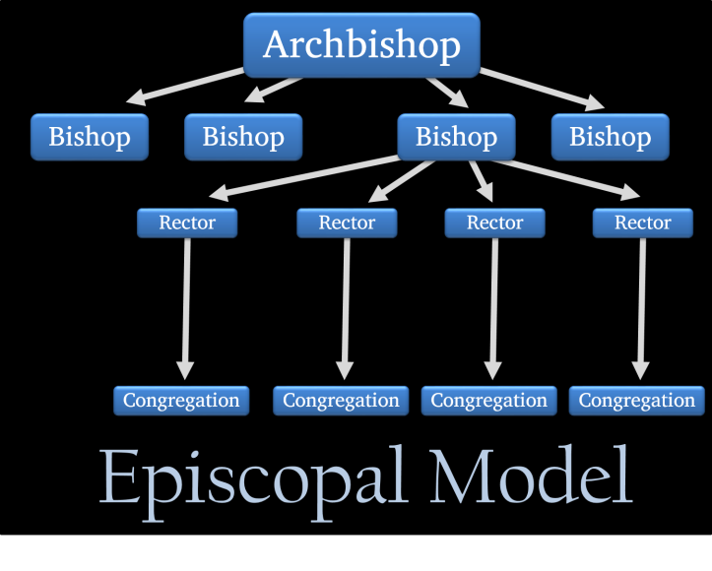
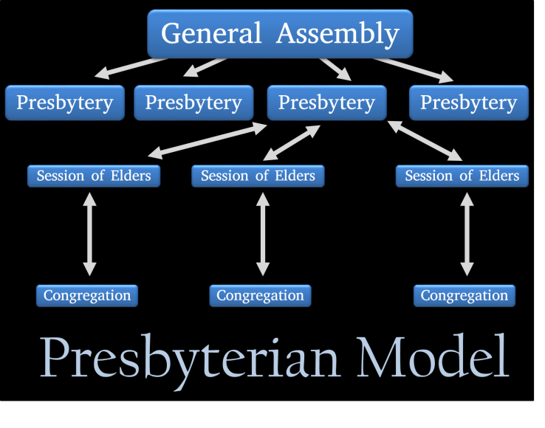
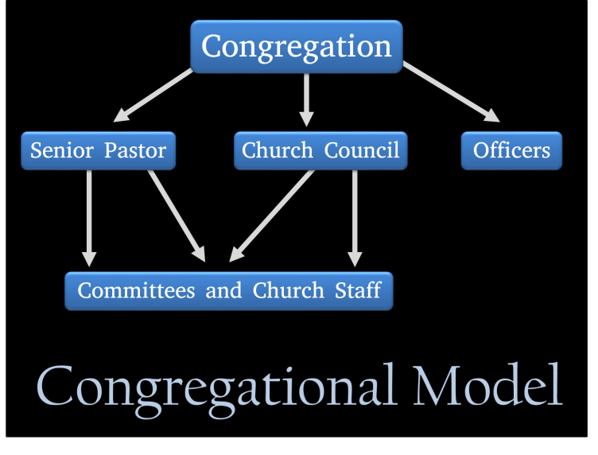
Almost all resources and papers say:
Church government can be categorized into three main models:
Episcopalian, Presbyterian and Congregational.

Slide 43

Episcopalian, Presbyterian and Congregational.
1. Episcopalian Model:
This model is also called the Hierarchical model.
This model is used by the Episcopalian, Catholic, Anglican and Orthodox churches.
Under this model:
A man at the top, called Pope or Archbishop, has overall say and rules over the bishops
The Bishops rule over the Rectors or Priests
The congregation takes all its teaching from those above it and can seldom challenge their teaching

Slide 44
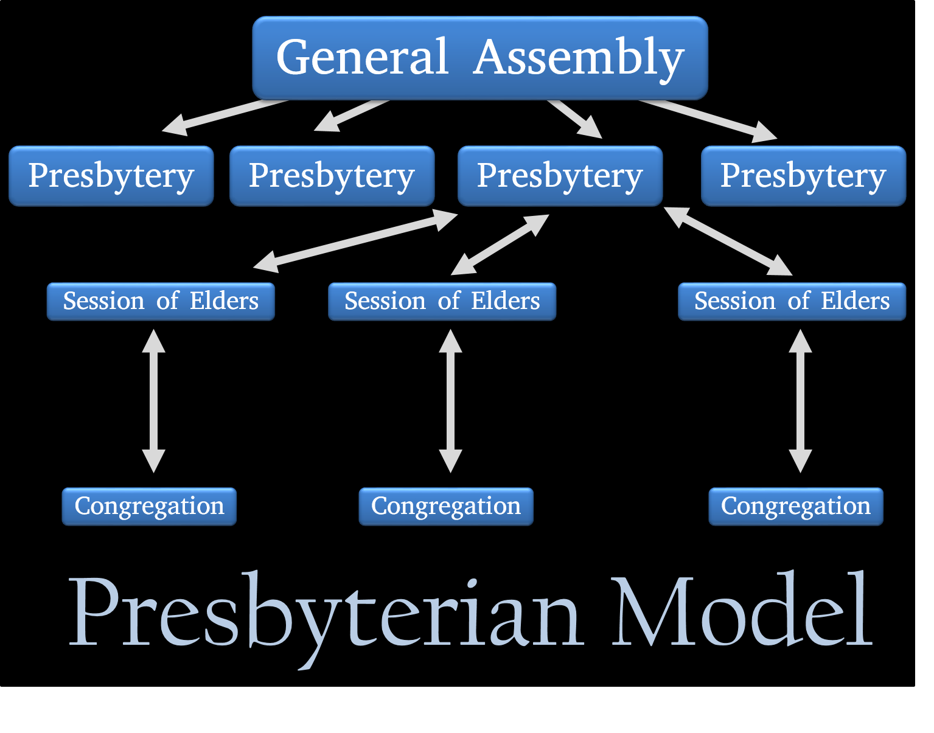
Episcopalian, Presbyterian and Congregational.
2. Presbyterian Model: Presbyterianism does not like 1 man being in charge.
This is used by Presbyterians, Reformed, and Lutheran churches.
Under this model:
The congregation elect elders to a “session” or board of elders who govern the local church
Some of these are elected to the presbytery, which governs over a group of churches.
They also have a General Assembly:
This is a group of presbytery elders who make decisions for all the churches in the denomination.

Slide 45

Episcopalian, Presbyterian and Congregational.
3. Congregational Model:
This model is used by Baptists, Free churches, Churches of Christ, and independent Bible churches.
Under this model:
The congregation rules the church by vote.
The congregation votes on who is to be their Pastor.
They vote at an annual meeting for committee leaders, major changes, and the budget etc.

Slide 46
Almost all resources and papers say:
Forms of church government can be categorized into three main models:
Episcopalian, Presbyterian and Congregational.
None of these
have any strong
Scriptural support

Slide 47
A New Testament Assembly

Slide 48
A New Testament Assembly
Everything begins with
The Lord Jesus Christ

Slide 49
A New Testament Assembly
The Lord Jesus Christ
is the Head of the body, the church.

Slide 50
A New Testament Assembly
The Lord Jesus Christ
is the Head of the body, the church.
Colossians 1:18
Ephesians 5:23

Slide 51
A New Testament Assembly
The Lord Jesus Christ
is the Head of the body, the church.
And he is the head of the body, the church:
who is the beginning, the firstborn from the dead;
that in all things he might have the preeminence.
Colossians 1:18
For the husband is the head of the wife,
even as Christ is the head of the church:
Ephesians 5:23

Slide 52
A New Testament Assembly
The Lord Jesus Christ
is the Head of the body, the church.
All who are saved (Christians)
have become members of the body, the church

Slide 53
A New Testament Assembly
The Lord Jesus Christ
is the Head of the body, the church.
All who are saved (Christians)
have become members of the body, the church
Becoming members not by any ritual
or ordinance or being baptized etc.
but by the simple act of saving faith
They are brought into the body of Christ

Slide 54
A New Testament Assembly
The Lord Jesus Christ
is the Head of the body, the church.
All who are saved (Christians)
have become members of the body, the church
1 Corinthians 12:27
Ephesians 5:30

Slide 55
A New Testament Assembly
The Lord Jesus Christ
is the Head of the body, the church.
All who are saved (Christians)
have become members of the body, the church
Now ye are the body of Christ, and members in particular.
1 Corinthians 12:27
For we are members of his body, of his flesh, and of his bones.
This is a great mystery: but I speak concerning Christ and the church. ^{v32}
Ephesians 5:30

Slide 56
A New Testament Assembly
The Lord Jesus Christ
is the Head of the body, the church.
All who are saved (Christians)
have become members of the body, the church
Now ye are the body of Christ, and members in particular.
1 Corinthians 12:27
For we are members of his body, of his flesh, and of his bones.
This is a great mystery: but I speak concerning Christ and the church. ^{v32}
Ephesians 5:30
Christians are brought into the universal church – the body of Christ
regardless of where they meet or go to on a Sunday

Slide 57
A New Testament Assembly
The Lord Jesus Christ
is the Head of the body, the church.
All who are saved (Christians)
have become members of the body, the church
Christians in a local area
come together to
form an Assembly gathering
Christians in a local area
come together to
form an Assembly gathering
Christians in a local area
come together to
form an Assembly gathering

Slide 58
A New Testament Assembly
The Lord Jesus Christ
is the Head of the body, the church.
All who are saved (Christians)
have become members of the body, the church
It is God’s will, as shown in the example of the early church
in Acts ch.2 that every Christian, although:
  They are saved
  They have a place secured in heaven
  They have the Holy Sprit within
  They are in the universal church, the body of Christ
  They have the Lord as Shepherd, Saviour and friend
  They should be part of the testimony in a local area in a local Assembly
  where God has appointed Elders as Shepherds to guide them
Christians in a local area
come together to
form an Assembly gathering
Christians in a local area
come together to
form an Assembly gathering
Christians in a local area
come together to
form an Assembly gathering

Slide 59
A New Testament Assembly
The Lord Jesus Christ
is the Head of the body, the church.
All who are saved (Christians)
have become members of the body, the church
Christians in a local area
come together to
form an Assembly gathering
Christians in a local area
come together to
form an Assembly gathering
Christians in a local area
come together to
form an Assembly gathering
We use the term ‘Assembly’
because ‘church’ has come to mean a building

Slide 60
A New Testament Assembly
The Lord Jesus Christ
is the Head of the body, the church.
All who are saved (Christians)
have become members of the body, the church
Christians in a local area
come together to
form an Assembly gathering
Elders are appointed to rule
Christians in a local area
come together to
form an Assembly gathering
Elders are appointed to rule
Christians in a local area
come together to
form an Assembly gathering
Elders are appointed to rule
It is in the local assembly
that elders are appointed to rule.

Slide 61
A New Testament Assembly
The Lord Jesus Christ
is the Head of the body, the church.
All who are saved (Christians)
have become members of the body, the church
Elders in a local Assembly are:
        Gifted by the Lord – Eph 4v11
        Raised up by the Spirit – Acts 20v28
        Recognised by the saints – 1 Thess 5v12
Christians in a local area
come together to
form an Assembly gathering
Elders are appointed to rule
Christians in a local area
come together to
form an Assembly gathering
Elders are appointed to rule
Christians in a local area
come together to
form an Assembly gathering
Elders are appointed to rule

Slide 62
1 Peter 5:1-4
​The elders which are among you I exhort,
There are different names given to Elders in the NT
They are always in the plural in each local Assembly.
The different names are instructive:

Slide 63
1 Peter 5:1-4
​The elders which are among you I exhort,
There are different names given to Elders in the NT
They are always in the plural in each local Assembly.
The different names are instructive:
      ELDERS: their maturity 1 Peter 5v1
      OVERSEERS (Bishops): their work Acts 20v28; Titus 1v7
      STEWARDS: their responsibility Hebrews 13v17
      PASTORS (Shepherds): their care Ephesians 4v11
      RULERS: their leadership Hebrews 13v7

Slide 64
1 Peter 5:1-4
​The elders which are among you I exhort,
There are different names given to Elders in the NT
They are always in the plural in each local Assembly.
The different names are instructive:
      ELDERS: their maturity 1 Peter 5v1
      OVERSEERS (Bishops): their work Acts 20v28; Titus 1v7
      STEWARDS: their responsibility Hebrews 13v17
      PASTORS (Shepherds): their care Ephesians 4v11
      RULERS: their leadership Hebrews 13v7
In the Bible these all refer to the same persons:
The elders.

Slide 65
1 Peter 5:1-4
​The elders which are among you I exhort,
Peter makes this appeal based upon three things:

Slide 66
1 Peter 5:1-4
​The elders which are among you I exhort,
    who am also an elder,
    and a witness of the sufferings of Christ,
    and also a partaker of the glory that shall be revealed:
Peter makes this appeal based upon three things:

Slide 67
1 Peter 5:1-4
​The elders which are among you I exhort,
    who am also an elder,
    and a witness of the sufferings of Christ,
    and also a partaker of the glory that shall be revealed:
Peter makes this appeal based upon three things:
Peter is a fellow elder.
(2) Peter is a witness of the sufferings of Christ.
(3) Peter is a partaker in the glory to be revealed.

Slide 68
1 Peter 5:1-4
​The elders which are among you I exhort,
    who am also an elder,
    and a witness of the sufferings of Christ,
    and also a partaker of the glory that shall be revealed:
Peter makes this appeal based upon three things:
Peter is a fellow elder.
He knows the challenges and difficulties of a shepherd over a local church.
He is writing to the shepherds as a shepherd himself. Jesus charged Peter to feed his sheep in John 21.
It is a call to courageous leadership in the face of suffering, they were not alone!
(2) Peter is a witness of the sufferings of Christ.
(3) Peter is a partaker in the glory to be revealed.

Slide 69
1 Peter 5:1-4
​The elders which are among you I exhort,
    who am also an elder,
    and a witness of the sufferings of Christ,
    and also a partaker of the glory that shall be revealed:
Peter makes this appeal based upon three things:
Peter is a fellow elder.
He knows the challenges and difficulties of a shepherd over a local church.
He is writing to the shepherds as a shepherd himself. Jesus charged Peter to feed his sheep in John 21.
It is a call to courageous leadership in the face of suffering, they were not alone!
(2) Peter is a witness of the sufferings of Christ.
Peter is not unaware of the suffering that these shepherds were enduring.
But Peter saw the suffering of our Saviour and Lord.
When suffering for righteousness’ sake, it helps to be reminded that the servant is not greater than his Lord
(3) Peter is a partaker in the glory to be revealed.

Slide 70
1 Peter 5:1-4
​The elders which are among you I exhort,
    who am also an elder,
    and a witness of the sufferings of Christ,
    and also a partaker of the glory that shall be revealed:
Peter makes this appeal based upon three things:
Peter is a fellow elder.
He knows the challenges and difficulties of a shepherd over a local church.
He is writing to the shepherds as a shepherd himself. Jesus charged Peter to feed his sheep in John 21.
It is a call to courageous leadership in the face of suffering, they were not alone!
(2) Peter is a witness of the sufferings of Christ.
Peter is not unaware of the suffering that these shepherds were enduring.
But Peter saw the suffering of our Saviour and Lord.
When suffering for righteousness’ sake, it helps to be reminded that the servant is not greater than his Lord
(3) Peter is a partaker in the glory to be revealed.
Although suffering now, the hope of the believer is in the glory that will come later.
Peter is sharing in that hope, looking forward to the glorious return of the Lord.
Peter got a sight of that glory on the mount of transfiguration!

Slide 71
1 Peter 5:1-4
​The elders which are among you I exhort,
    who am also an elder,
    and a witness of the sufferings of Christ,
    and also a partaker of the glory that shall be revealed:
Peter makes this appeal based upon three things:
Peter is a fellow elder.
He knows the challenges and difficulties of a shepherd over a local church.
He is writing to the shepherds as a shepherd himself. Jesus charged Peter to feed his sheep in John 21.
It is a call to courageous leadership in the face of suffering, they were not alone!
(2) Peter is a witness of the sufferings of Christ.
Peter is not unaware of the suffering that these shepherds were enduring.
But Peter saw the suffering of our Saviour and Lord.
When suffering for righteousness’ sake, it helps to be reminded that the servant is not greater than his Lord
(3) Peter is a partaker in the glory to be revealed.
Although suffering now, the hope of the believer is in the glory that will come later.
Peter is sharing in that hope, looking forward to the glorious return of the Lord.
Note the themes of suffering and glory
and the present linked
with the future

Slide 72
1 Peter 5:1-4
Peter cautions the elders with 3 ‘not – but’ sentences:
Feed the flock of God which is among you,
    taking the oversight thereof, not by constraint, but willingly;
    not for filthy lucre, but of a ready mind;
    Neither as being lords over God's heritage, but being ensamples to the flock.

Slide 73
1 Peter 5:1-4
Peter cautions the elders with 3 ‘not – but’ sentences:
Feed the flock of God which is among you,
    taking the oversight thereof, not by constraint, but willingly;
    not for filthy lucre, but of a ready mind;
    Neither as being lords over God's heritage, but being ensamples to the flock
Not by constraint but willingly:
(2) Not for filthy lucre but of a ready mind
(3) Not as Lords over but as examples to the flock

Slide 74
1 Peter 5:1-4
Peter cautions the elders with 3 ‘not – but’ sentences:
Feed the flock of God which is among you,
    taking the oversight thereof, not by constraint, but willingly;
    not for filthy lucre, but of a ready mind;
    Neither as being lords over God's heritage, but being ensamples to the flock
Not by constraint but willingly:
Peter is exhorting the elders to love their work and be willing to do it.
Be willing to feed and to tend the sheep.
(2) Not for filthy lucre but of a ready mind
(3) Not as Lords over but as examples to the flock

Slide 75
1 Peter 5:1-4
Peter cautions the elders with 3 ‘not – but’ sentences:
Feed the flock of God which is among you,
    taking the oversight thereof, not by constraint, but willingly;
    not for filthy lucre, but of a ready mind;
    Neither as being lords over God's heritage, but being ensamples to the flock
Not by constraint but willingly:
Peter is exhorting shepherds to love their work and be willing to do it.
Be willing to feed and to tend the sheep.
(2) Not for filthy lucre but of a ready mind
Filthy lucre means selfish gain – like the hireling in John 10
A ready mind means a very keen interest in the sheep, enthusiastic and eager to help
(3) Not as Lords over but as examples to the flock

Slide 76
1 Peter 5:1-4
Peter cautions the elders with 3 ‘not – but’ sentences:
Feed the flock of God which is among you,
    taking the oversight thereof, not by constraint, but willingly;
    not for filthy lucre, but of a ready mind;
    Neither as being lords over God's heritage, but being ensamples to the flock
Not by constraint but willingly:
Peter is exhorting shepherds to love their work and be willing to do it.
Be willing to feed and to tend the sheep.
(2) Not for filthy lucre but of a ready mind
Filthy lucre means selfish gain – like the hireling in John 10
A ready mind means a very keen interest in the sheep, enthusiastic and eager to help
(3) Not as Lords over but as examples to the flock
Lording it over means demanding things to be done that you wouldn’t do yourself
Rather than telling people what to do – show them by example!

Slide 77
1 Peter 5:1-4
​The elders which are among you I exhort,
    who am also an elder,
    and a witness of the sufferings of Christ,
    and also a partaker of the glory that shall be revealed:
Feed the flock of God which is among you,
    taking the oversight thereof, not by constraint, but willingly;
    not for filthy lucre, but of a ready mind;
    Neither as being lords over God's heritage, but being ensamples to the flock.
And when the chief Shepherd shall appear,
ye shall receive a crown of glory that fadeth not away.

Slide 78
1 Peter 5:1-4
And when the chief Shepherd shall appear,
ye shall receive a crown of glory that fadeth not away.
The Lord Jesus Christ
is the chief Shepherd
Elders are under-shepherds
There is a chief shepherd who
oversees all the under-shepherds
and all of the flock
All under-shepherds (elders) and sheep
are in the flock of the chief Shepherd

Slide 79
1 Peter 5:1-4
And when the chief Shepherd shall appear,
ye shall receive a crown of glory that fadeth not away.
We next want to consider:
When shall the chief Shepherd appear?
How shall the chief Shepherd appear?
What will be received
when the chief Shepherd appears?
The Lord Jesus Christ
is the chief Shepherd
Elders are under-shepherds
There is a chief shepherd who
oversees all the under-shepherds
and all of the flock
All under-shepherds (elders) and sheep
are in the flock of the chief Shepherd

